Slide 1
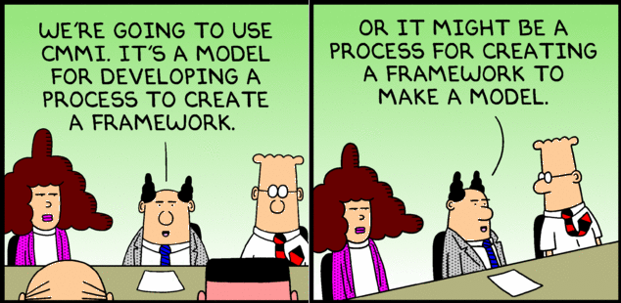
System Diagrams
A Visual representation of the system

Slide 2
Model
  A model is a description from which detail has been removed in a systematic manner and for a particular purpose
  A simplification of reality intended to promote understanding
  Models are the most important engineering tool, they allow us to understand and analyze large and complex problems
  A model can be:
    A picture
    A visual flow (sequence, flowchart, relationship)
    A formula that approximates a metric related to an attribute of the system (performance, complexity, usability, …)
    A model can describe different views of the system
https://www.cl.cam.ac.uk/teaching/1112/SWDesign/softwaredesign01.pdf

Slide 3
Views and Models
User Model
How a user interacts with the software
  Flowcharts; process maps; …
Interface view
How different APIs are used
  Sequence diagrams;
System View
How components interact with each other
  Main components; connections; operations; …
Performance Model
How you can calculate the performance of an operation or operations within certain scenarios
  Spreadsheets; formulas; …

Slide 4
Types of Views
  System Diagram – Abstract description of the system whose requirements are being modeled
  Module View – Define the structure of the code base
  Component and Connector Views – Specify the structure and behavior of runtime elements in the system
  Allocation Views – The mapping of software units to elements of an environment
  Quality Views – A view created by extracting relevant pieces of structural views and packaging them together
  Behavior Views – Describe interactions between components while the system is a specific state

Slide 5
Which Views? The Ones You Need!
Different views support different goals and uses
The views you document depend on the stakeholders and uses of the documentation.
Each view has a cost and a benefit; the benefits of maintaining a view should outweigh its costs
At a minimum, at least on module view and one component and connector view

Slide 6
System Diagram
  Abstract Description of the system whose requirements are being modeled
Components of a System Diagram:
  Boundaries of the overall system
  Inputs to and outputs from the system
  Subsystems of the system
  Identification of the interfaces between the subsystems
  A System Diagram is a high-level model of the system.
  It also describes decisions make on the overall high level design

Slide 7
Why Create a System Diagram?
  To help explain the proposed requirements to other system stakeholders.
  To discuss design proposals with engineers and to document the system for implementation.
  To show the organization and architecture of the system.

Slide 8
Type of System Diagrams
System Diagrams are variable in their view of the system
A system diagram can show
- Components
- Interactions
- Boundaries
- …
Choose the type of information you want to convey AND what questions you are trying to answer
  Big blocks
  APIs
  Physical assets
  Data or communications
  …
Then select HOW you will show it
Components & Interactions tend to be the most common

Slide 9
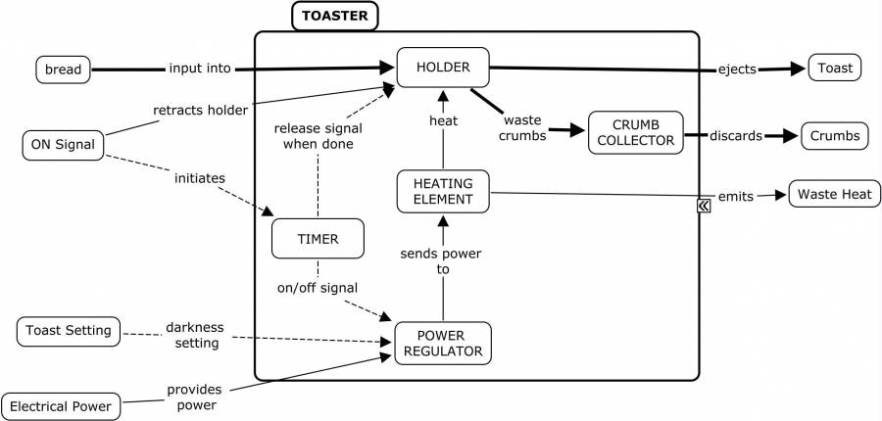
Toaster System Diagram:
Inputs
Outputs
System
Where’s the WIFI connection?
https://deseng.ryerson.ca/dokuwiki/_detail/design:toasterarchitecture.jpg?id=design%3Asystem_diagram

Slide 10
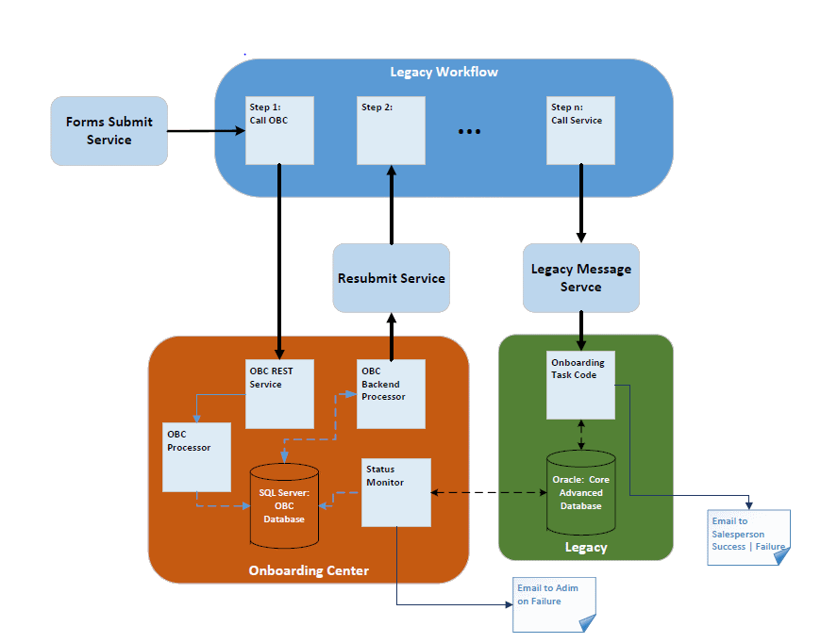
Onboarding System
Notes:
Early prototype of the system built to illustrate that a new service could be interposed in the legacy workflow and enrich the content flowing into the Legacy System (Green box).

Slide 11
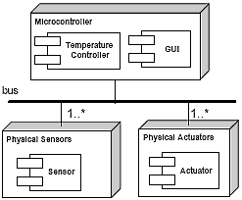
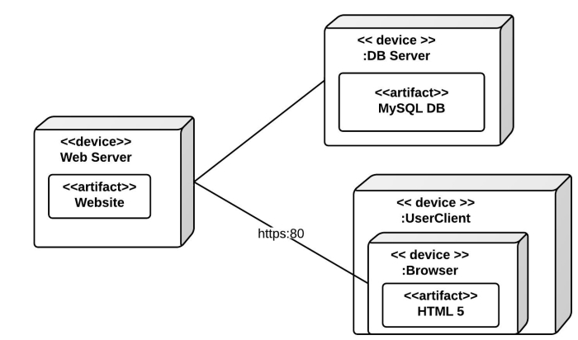
Allocation View Example

Slide 12
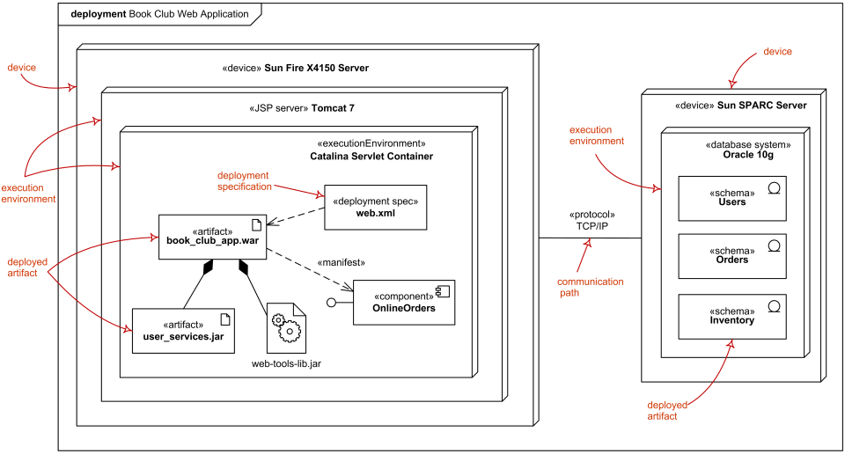
Allocation View
UML Deployment Diagram Example

Slide 13
Usage of Allocation Views
Specify structure and behavior of runtime elements such as processes, objects, servers, data stores
Reasoning and decisions about …
  What hardware and software is needed
  Distributed development and allocation of work to teams.
  Builds, integration testing, version control
  System installation
  Deployment
Elements
  Software element
    Some runtime packaging of logical modules and components (e.g., processes)
  Environmental element - execution (hardware, runtime operation) or development (file structure, deployment, development organization)
    Properties that are provided to the software; e.g., bandwidth
Relations
  Allocated to - a software element is mapped (allocated to) an environmental element
  Static or dynamic (e.g., resource allocation)

Slide 14
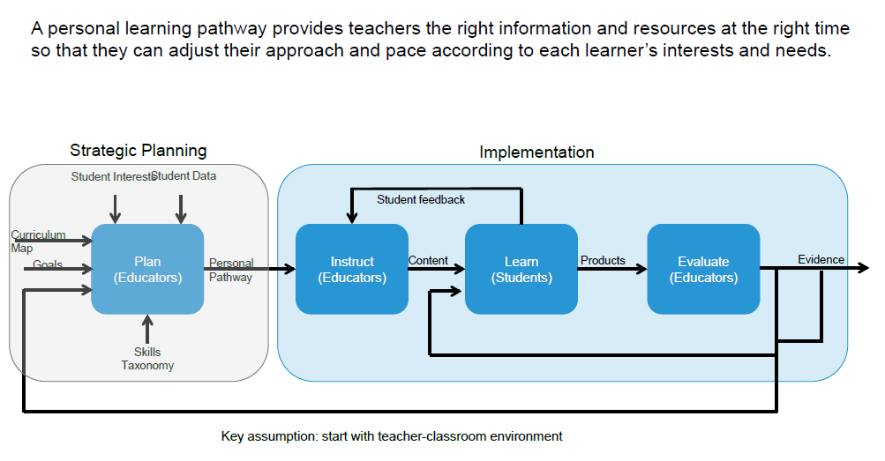
Personal Learning Pathways: Systems View
Notes:
A system designed at PARC for Personalized Learning. Used to discuss the system with school administrators, teachers and parents

Slide 15
Unit of study as a context for prototyping
Student Performance
Learn
(Students)
Feedback for instruction & planning
Student Profile
Instruct
(Teacher)
Practice
Plan
(Teacher)
Paths
Evaluate
(Teacher)
Evidence
Demo
Content, Curriculum map
Student Profile
Alerts
Goals and Interests
SIS
Unpack concepts
Sequence
Scaffold
Model
Assign
Score
Monitor
Adjust
Communicate
Collaborate
Teach interventions
Mastery
Growth
Portfolio
  Exemplar
  Parent/teacher
  APPR
  Issue tracking
Practice (assignments, check-ins, formative assess)
Demonstrate (summative, benchmark)
Collaborate (teachers, peers)
Reflect on student performance
Student Performance
Pre-assessment
ELA summary
Writing samples
Paths
Mastery visualization
Student grouping
Key messages
Providing teachers a dynamic, holistic view of each student facilitates personalization day-to-day.
Easy and timely access to the desired information is a key challenge.
Understanding what teachers do with this information guides future development.
15
Notes:
A more detailed view that layers in where various functionality exists in the system. The circled items are were the development team was initially focused.

Slide 16
Metrics & Performance: Allocation to the system
Database usage:
Average query: 2Kbytes
  Queries/ Day: 20,000
  Transactional load: Queries/ Day x Query size
Retail
  Size of item: 1k
  # of items: 5000
  Size of DB Storage: 5000 x 1,000 = 5MB
Performance:
  Image recognition system
    10 seconds per operation
    10,000 request per minute
    100,000 seconds CPU time required per minute**
** Will that work?

