Slide 1
RLES
R-what now?

Slide 2
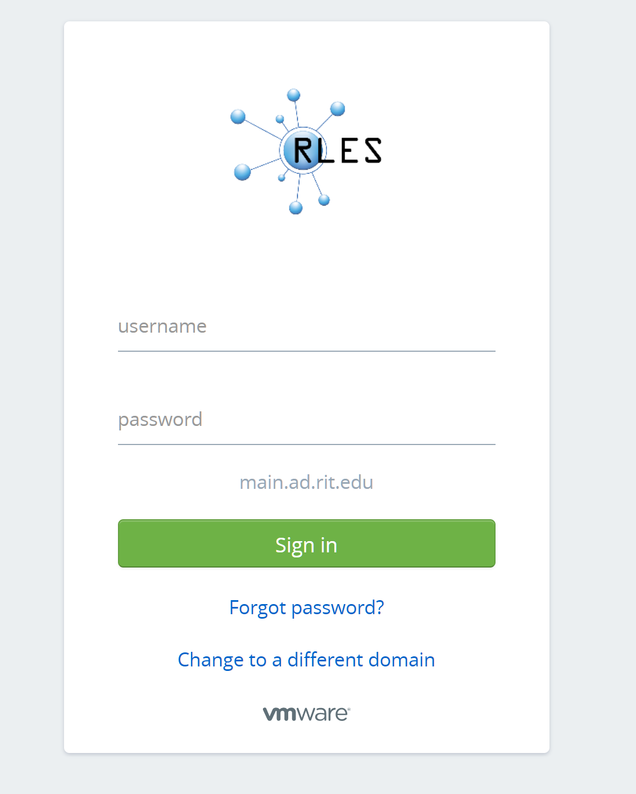
1. Log in here: https://rlescloud.rit.edu
  Use your main RIT account!

Slide 3
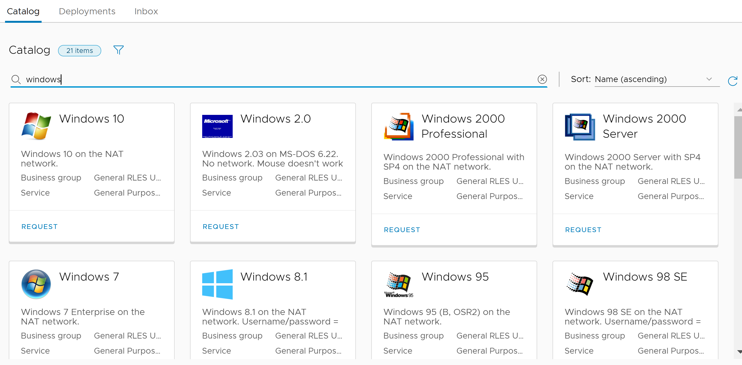
Select VM
2. On the Catalog tab, click the Request button for Windows 2016 Server (or whatever):
Select a VM from the Catalog (you can filter by typing ‘windows’ in the search area)
Select the Windows 10 VM and click ‘Request’

Slide 4
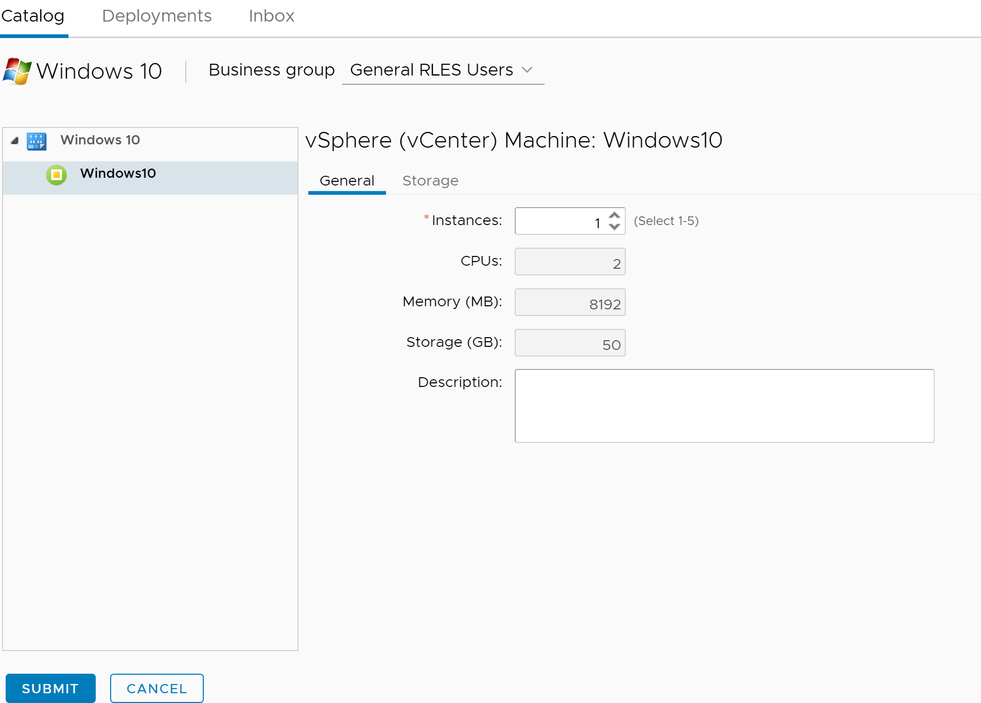
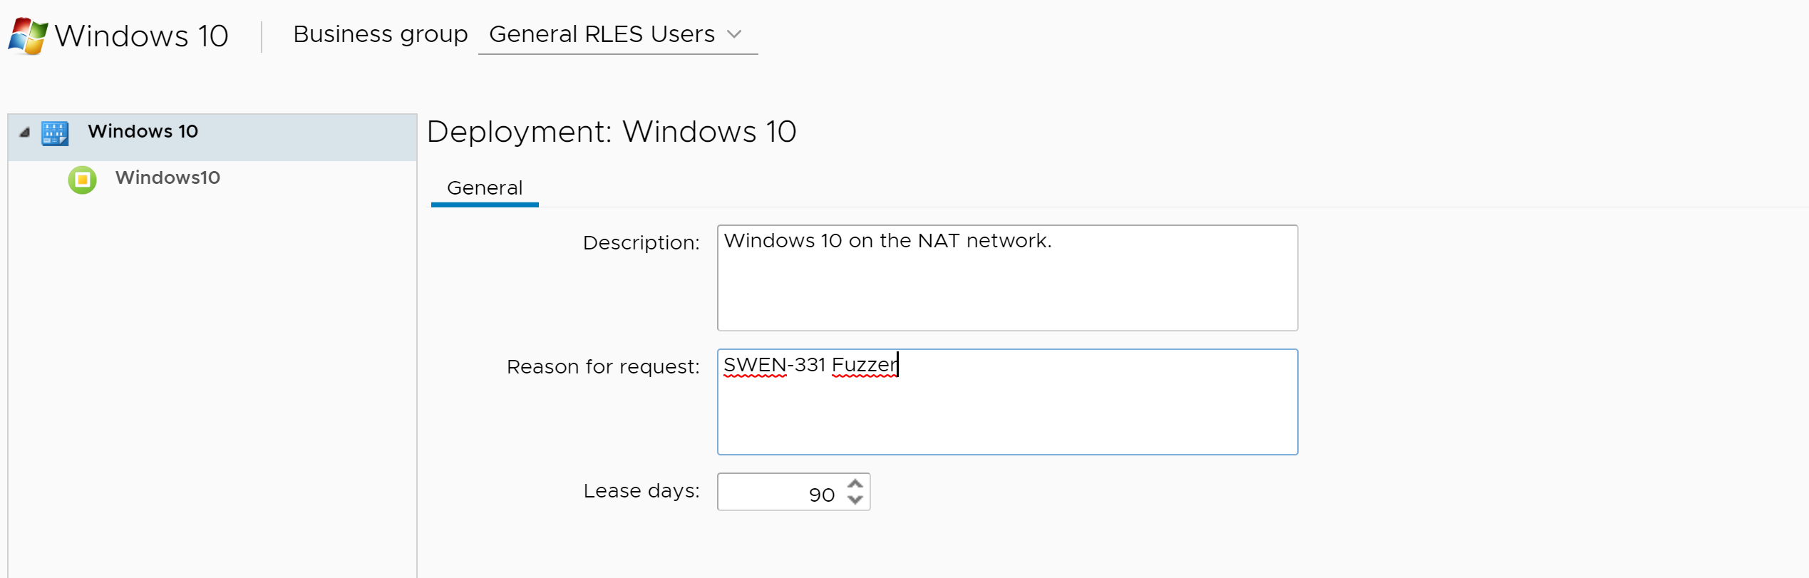
Enter Info
Enter reason for request
Leave as defaults, click submit

Slide 5
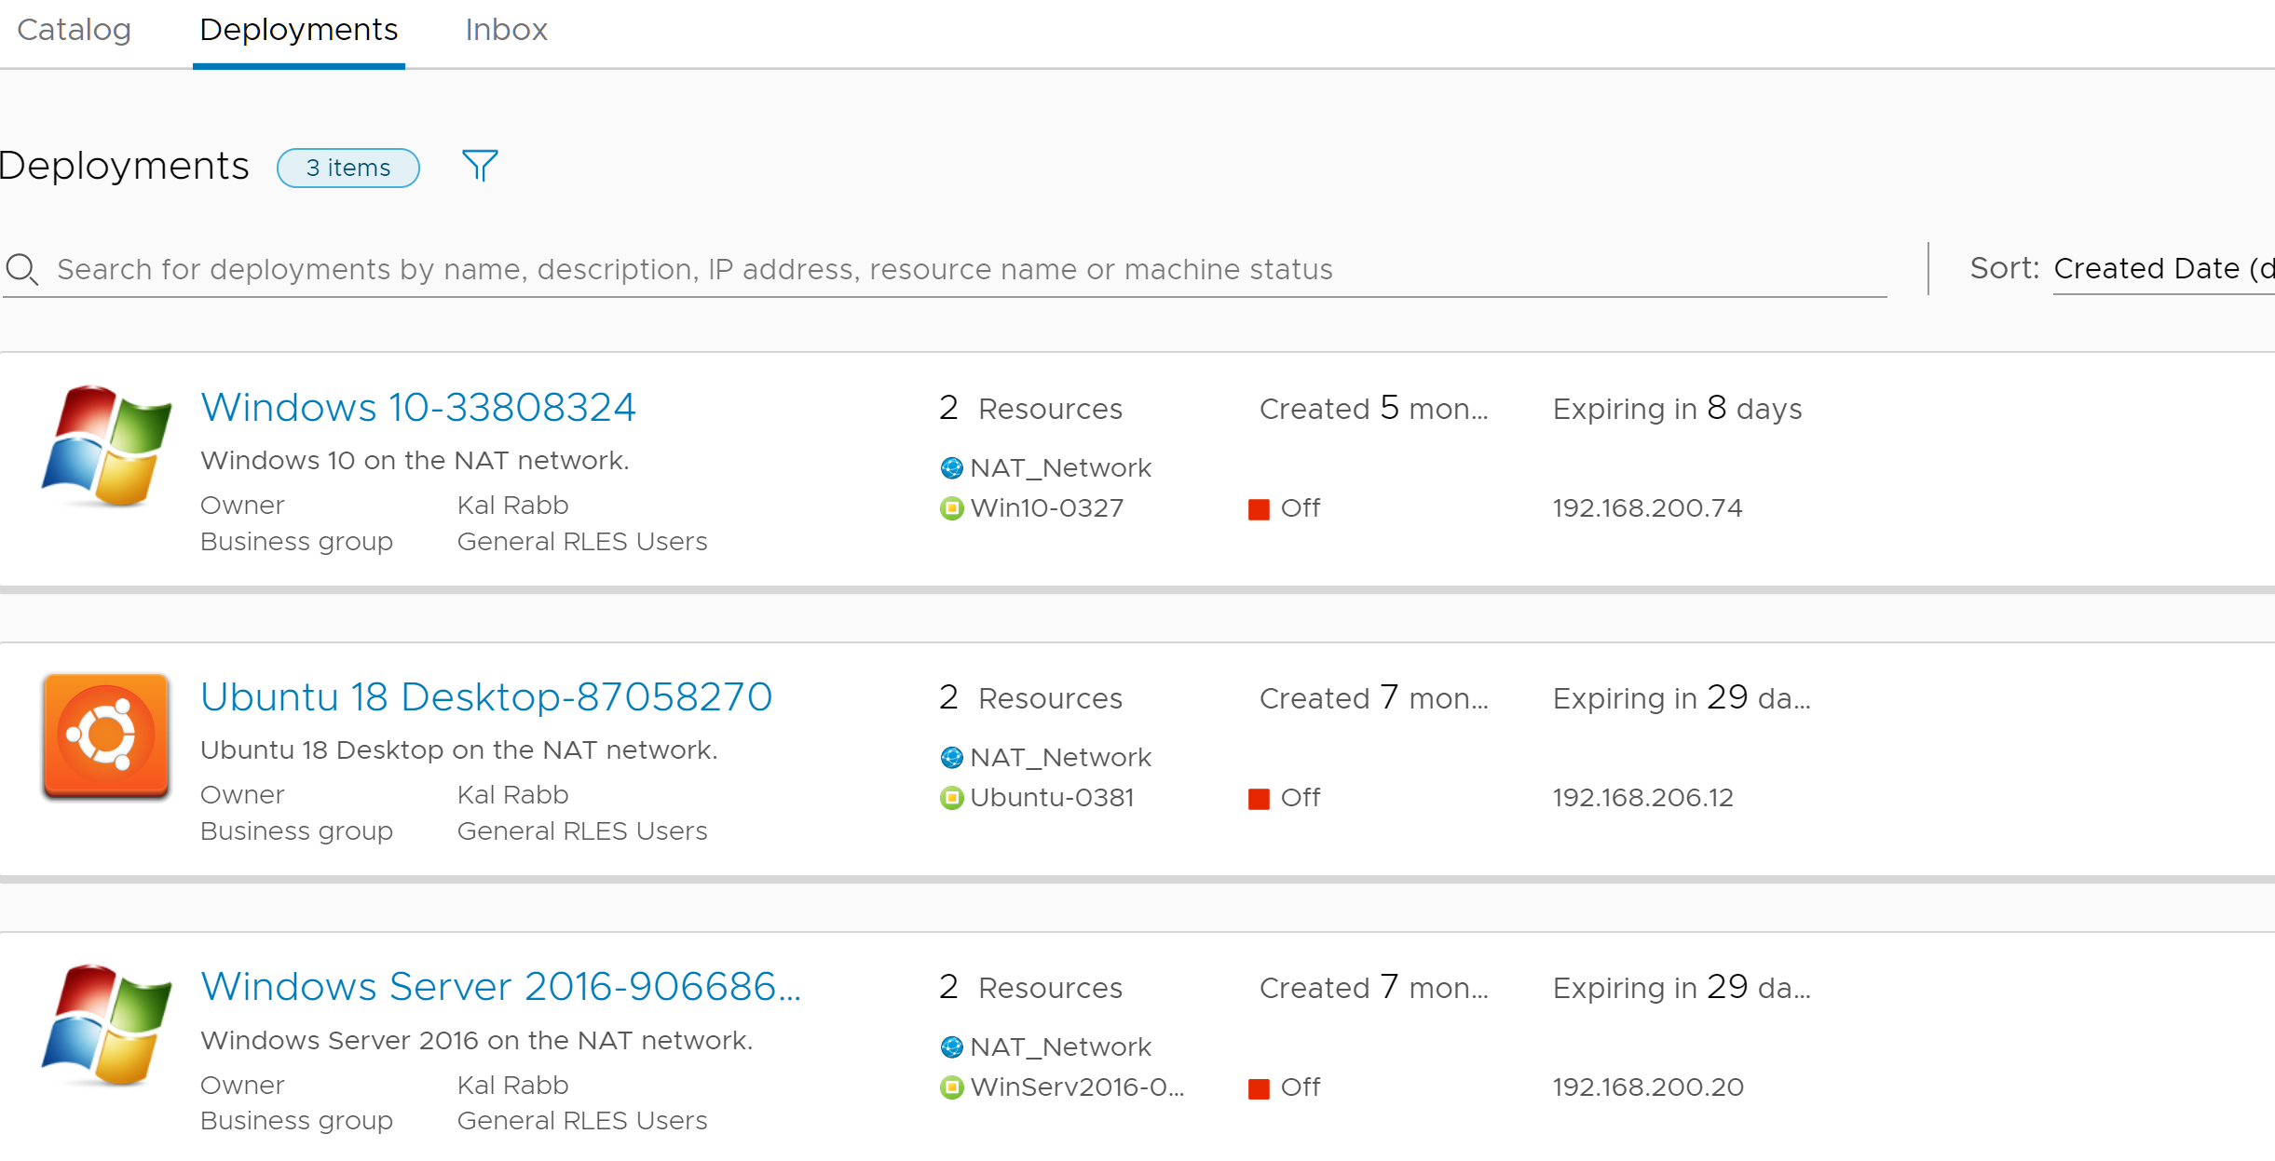
Now what?
You will receive emails on progress of VM creation.
Once complete, you can login (student/student)
Click on ‘deployment’ to see your VMs

Slide 6
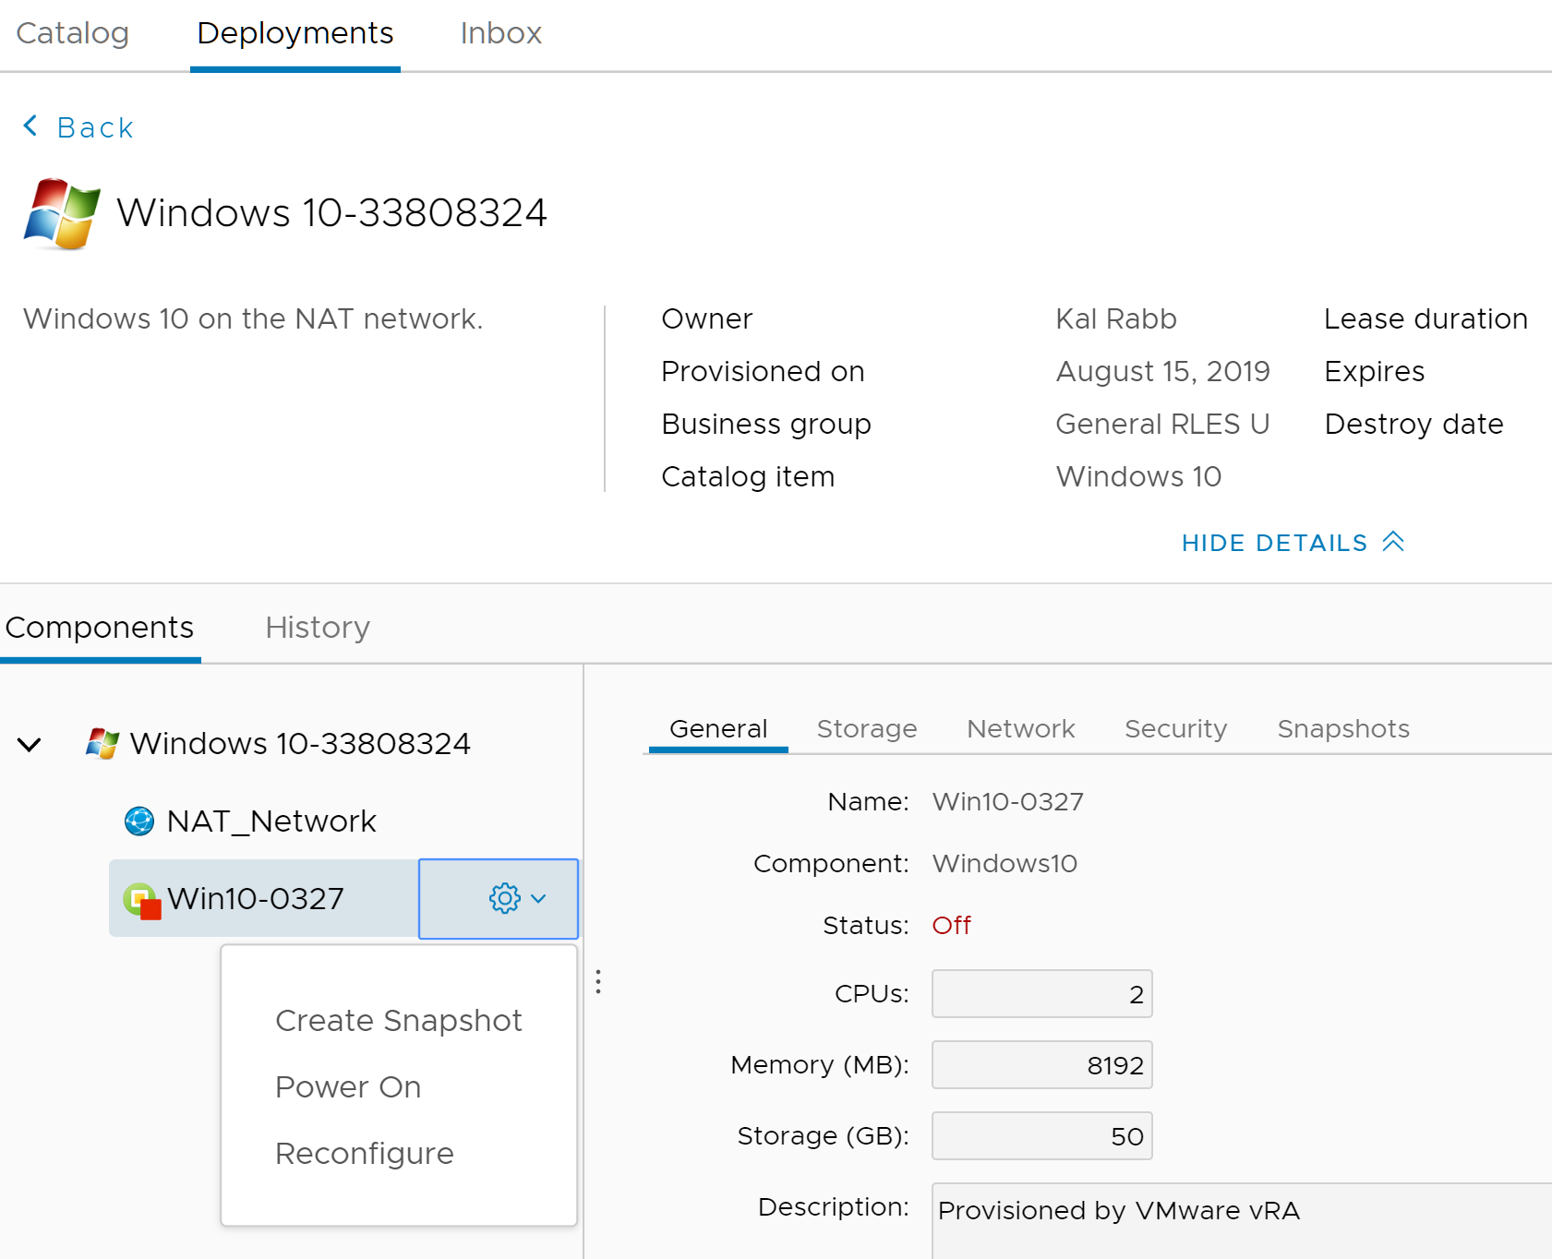
Deployment
Click the VM to make sure it’s powered on
Again, you will receive emails on progress

Slide 7
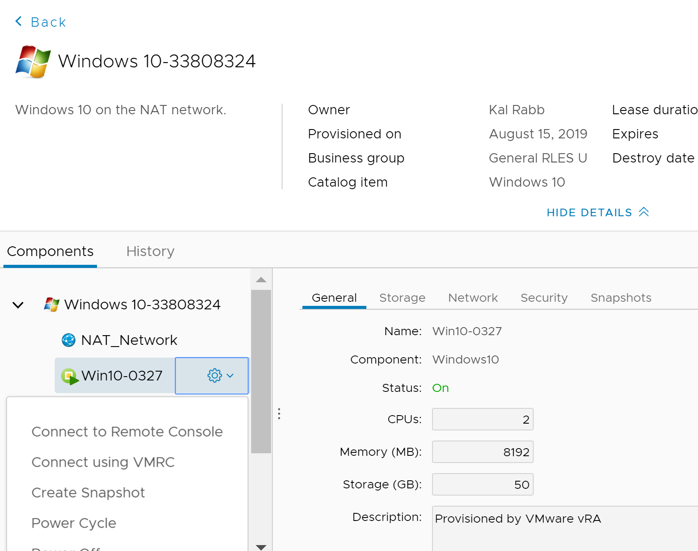
Console
Once powered on, open up the VM using ‘Connect to Remote Console’

