Slide 1
Communications

Slide 2
How do processes communicate?
Within a process
Shared data
Internal function call
Can be used in single threaded
Can be used in multi-threaded (refer to OS slides)
Between processes
IPC (Interprocess communication)

Slide 3
Basic function calls … WITHIN a process
Stack
SomeFunction()
Stack
{
callMyFunction(
…
param1
int p1,
callMyFunction(
param2
float p2,
param1,
param3
double p3){
param2,
&callMyFunction
…
param3)
&nextCommand
callMyFunction(
nextCommand
param1,
…
param2,
}
param3)
Heap
…
Heap
}
Essentially:
Each param is pushed onto a stack (param1 then param2 then param3)
The programCounter (address) for the returning function is pushed
The program address for the function-to-be-called is pushed
The OS is told to jump to the address on the process stack
Data
Data
Text
Text

Slide 4
And so …
This is how communications works within a single application
Given you have factored your code into multiple pieces (classes, functions, …)
  You can ‘call’ each piece with a function call or something equivalent
Application memory is used to keep track of data and addresses using Stack memory
Question:
  What happens when you get a stack overflow? (Yeah, it’s not just a place online to find code snippets)…
    Too many parameters, callback/ return addresses
      Often from infinite loops, recursion

Slide 5
Multiple Processes
This does NOT work?
Why?
Each process is in it’s own address space
The Data Stack is NOT shared
The process addresses are not known from Application A to Application B.
There is a failure to communicate! (Apologies to Cool Hand Luke)
And so … we need IPC

Slide 6
Why do processes need to communicate?
  Information sharing
  Computation speedup
  Modularity and protection
  Enable multitasking

Slide 7
Types of Interprocess Communication
File system
Sockets
Pipes
Shared memory
Message Queues
It is (really) an API i.e. a ‘contract’ of how to communicate with/ between software
But it is unstructured and untyped
  All manual documentation to define the interface
  Not compile time enforced
  Can have runtime error checks for format
  Example: Configuration files (think .ini files; think registry; think UNIX .rc or .cfg files)
  Example: Windows Message Queues (look it up)

Slide 8
File
Simple – Producer writes file, Consumer reads file
Both parties must agree on a known location
Need to account for Producer and Consumer both accessing the file at the same time.
  Consumer reading an incomplete file
  Deletion of file out from under Producer
Need a semaphore to signal when a file is ready for consumption

Slide 9
Shared memory
A global shared memory location is established
Each process can read/ write to that location and communicate
Similar to global variables, except outside the process memory space
May need a semaphore to prevent reading and writing at the same time
Examples: Printers – PDL decomposed into bitmap in shared memory, printer consumes bitmap

Slide 10

Pipes
Type of message queue
Specifically between two processes (client/ server or peer-peer)
Acts like a FIFO message list
Push a message in, receiver pulls the message out
Scan all open ports and list only occurrences of port 22:

Slide 11
Sockets
Like a pipe, but uses network socket vs. global memory
Local processes can also listen on a socket so this is still IPC
Example: Localhost
Specifics: When you run a webserver on your PC (for debug), the server is ‘listening’ on Port 8001 (for example) for HTTP messages to process

Slide 12
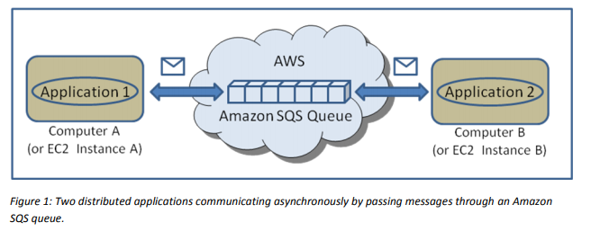
Message Queues
Like shared memory, but structured and with controls on send/ receive
Global memory assigned for incoming messages
Processes place a message in the queue
Other process(es) read the message and remove from the queue as they use it
Like a mailbox for software
Examples: Windows Message Queues
http://sqs-public-images.s3.amazonaws.com/Building_Scalabale_EC2_applications_with_SQS2.pdf

Slide 13
Deadlock
A set of processes is in a deadlock state when every process in the set is waiting for an event that can only be caused by another process in the set.
A deadlock situation can arise if and only if the following four conditions hold simultaneously in a system:
Mutual Exclusion: At least one resource is held in a non-sharable mode
Hold and Wait: There must be a process that is holding at least one resource and is waiting to acquire additional resources that are currently held by other processes
No Preemption: Resources cannot be preempted
Circular Wait: There must be a set {p0, p1, …, pn} of waiting processes such that p0 is waiting for a resource which is held by p1, p1 is waiting for a resource held by pn and pn is waiting for a resource held by p0.
Peterson, et al, Operating System Concepts, p.275-276

Slide 14
So now…
You have seen different ways to create an application, communicate between applications
How do you know which mechanism to use?
This will come down to requirements
Reminder: ASR = Architecturally significant requirements
Things that affect
- How you decompose
- How you communicate
- How you have an efficient and reliable program

Slide 15
And now – you know how an application runs – let’s put it in practice
Activity:
Investigate application communications, using a ‘producer-consumer’ pattern. (So far we have seen the layered architecture pattern in OS. We’ll see more of these later)
Producer-consumer:
Concept:
Basically, an application that creates some output is the producer. An application that consumes (uses) some item (input) is a consumer. (See activity document)
The two applications need *some* way to exchange information (Hint: Think IPC!)
In this activity you will write up your approach, and we will discuss in class.
Download the activity document from the website. You will submit your work to myCourses

