Slide 1
How about that Crowdstrike?
So why is Software Engineering important?

Slide 2
What happened
July 19 2024
  Many Windows PCs & Servers crashed and went into an infinite reboot
  Servers (including cloud) → everything hosted died
    Governments
    Airports
    Hospitals
    Banks
    Retail
    Mass media
    Etc
    Except China & Russia (used their own solutions)
Largest IT outage in history
  $10 billion losses worldwide
  Fix released within hours
  But took DAYS to apply
    For some companies (Delta Airlines) WEEKS
  ~8.5M devices affected.
    Not a lot, but many were critical
CrowdStrike outage: We finally know what caused it - and how much it cost | CNN Business

Slide 3
Why?
Crowdstrike hunts for viruses / corrupt files / memory-based malware
  Very low level
  Monitors:
    System calls
    Kernel memory
    Process creation
    I/O patterns
  Needs high privilege kernel access
  Takes over before the OS boots
    Firmware -> Win bootloader -> kernel -> drivers -> the rest
    CS loads, loads faulty data => crash, reboot, again
    So Windows has no opportunity to intervene!!
Application
OS
Kernel

Slide 4
The Fix
Manual
Boot into ‘safe’ mode
Delete the offending .sys file
Impossible to do remotely
  In most cases
  8kk+ computers
    Fix manually every one of them
    Engineers didn’t sleep for days
  Many in data centers
    Without monitors

Slide 5

What Went Wrong?
Need kernel permissions
Emulated a driver
Driver must be certified by MS
Crowdstrike wanted to deliver updates FAST
  Certification takes time (a lot)
  Crowdstrike was loading dynamic rules
    Into the kernel space
    Without certification

Slide 6
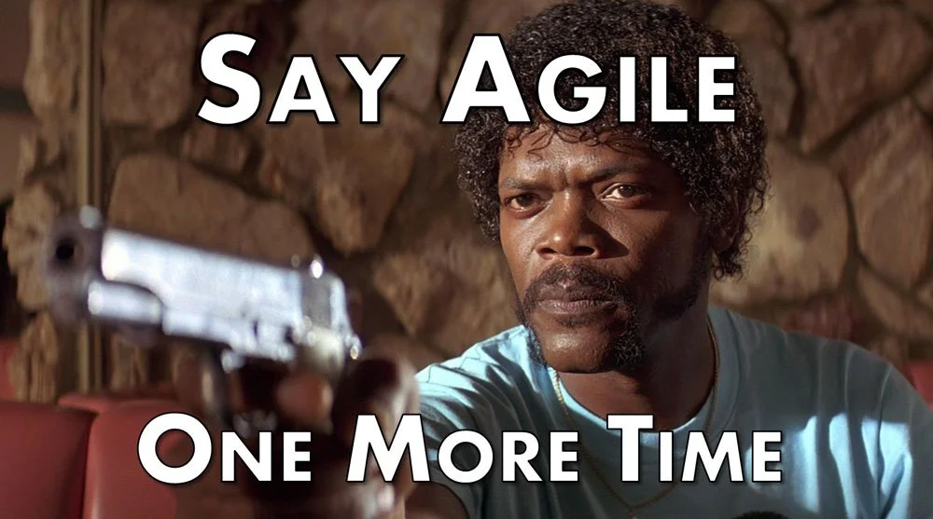
What went wrong?
What about testing?
  Rules were validated (syntax)
    Automatically
      Tests didn’t check the number of elements in the rule
    Code review
      Looked fine
  Driver was tested
    With “test” rules
  How the driver read those rules – wasn’t checked!
  Stage testing – skipped!
  No canary testing!
  Were trusted by governments & largest companies in the world

Slide 7
Responsibilities
Architecture issues
  Boot monitor, integrity check: Crowdstrike
    If something crashes N times … roll back the change!!
    Make sure data files are correct!
  Pre-boot monitor: Microsoft
    If the BSOD occurs, drop to safe mode
Process issues
  Crowdstrike - testing
  Microsoft - contractual terms
    Do not allow dynamic load into kernel
    And provider of kernel level mode MUST prove:
      Robust process
      Boot monitor with auto recovery

Slide 8
Root Cause & Consequences
MS forced to open the kernel to 3rd parties
  due to a 2009 EU Anti-monopoly
Apple doesn’t allow 3rd parties kernel level access
  Doesn’t have this problem
Highly interconnected world
  Consolidation of providers (Crowdstrike and MS)
  Dependency on networked services
    Vs. just one machine dying
  Can cause global outage by one 1 bug in 1 place
    Lucky it wasn’t Linux
Cascade failures can VERY easily happen
Higher responsibility for software engineers

Slide 9
The SE Linkage …
Designing clever algorithms and modules is great
  Crowdstrike driver was great
But you need people who
  Understand the system
    What can go wrong?
  Design robust systems
    How to prevent it?
  See the business context
  Define and operationalize the whole SDLC process
    Hello, insufficient testing processes
  Ask questions
    What happens if a kernel module fails?
    How do we roll it out?
    Can we roll it back?
    Any of these would prevent the situation
This is Software Engineering
Not writing code

Slide 10
Nitty Gritty Details
"Channel File 291 controls how Falcon evaluates named pipe execution on Windows systems. Named pipes are used for normal, interprocess or intersystem communication in Windows," CrowdStrike explained in a technical summary published over the weekend.
The configuration update triggered a logic error that resulted in an operating system crash
"The update that occurred at 04:09 UTC was designed to target newly observed, malicious named pipes being used by common C2 frameworks in cyberattacks. The configuration update triggered a logic error that resulted in an operating system crash."
Translation: CrowdStrike spotted malware abusing a Windows feature called named pipes to communicate with that malicious software's command-and-control (C2) servers, which typically instruct the malware to perform all sorts of bad things. CrowdStrike pushed out a file update to detect and block that misuse of pipes, but the definition data broke Falcon.
While there has been speculation that the error was the result of null bytes in the Channel File, CrowdStrike insists that's not the case.
"This is not related to null bytes contained within Channel File 291 or any other Channel File," the cybersecurity outfit said, promising further root cause analysis to determine how the logic flaw occurred.
Specific details about the root cause of the error have yet to be formally disclosed – CrowdStrike CEO George Kurtz has just been asked to testify before Congress over this matter – though security experts such as Google Project Zero guru Tavis Ormandy and Objective-See founder Patrick Wardle, have argued convincingly that the offending Channel File caused Falcon to access information in memory that simply wasn't present, triggering a crash.
It appears Falcon reads entries from a table in memory in a loop and uses those entries as pointers into memory for further work. When at least one of those entries was not correct or present, as a result of the channel file's contents, and instead contained a garbage value, the kernel-level code used that garbage as if it was valid, causing it to access unmapped memory.
That bad access was caught by the processor and operating system, and sparked a BSOD because at that point the OS knows something unexpected has happened at a very low level. It's arguably better to crash in this situation than attempt to continue and scribble over data and cause more damage.
A closer look at what caused the CrowdStrike Windows crashes • The Register

Slide 11
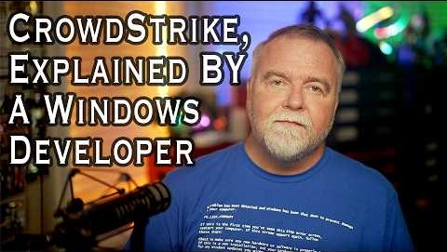
A Windows Dev Explains Crowdstrike

