Slide 1
Queuing Theory: Exponential Distribution

Slide 2
Describing traffic
How can we describe traffic? Cars, pedestrian, internet, etc.
Also: how can we describe how traffic is processed?
What are some metrics?
  Rate at which people arrive somewhere,
  e.g. “customer arrival rate per hour”
  Average “downtime”
  Time between people arriving
In Queuing Theory, we use stochastic systems to model events
  Probability of an event occurring (counts)
  Always over a period of time (continuous)

Slide 3
Random Variables
“Randomness can be described as unpredictable in the short term, but predictable in the long term“
-Prof. Pruim,
(pronounced “prime”)
Meneely’s favorite Math Professor
Random Variables are a mathematical construct used to abstract away a complex system that behaves stochastically
  Represent the complex physics of rolling a die with 1 variable
  Flipping a coin
Random variables can be discrete or continuous
  e.g. flipping a coin
Random variables are described by distributions

Slide 4
Distributions You Might Know
Most distributions have at least one parameter define the whole distribution
Every distribution has an input
Uniform distribution
  Parameter: n (number of sides on the die)
  Can be discrete or continuous
  Fair die, e.g. f₆(x=1) is 1/6
Binomial distribution
  Discrete
  Parameter: p (probability of an event)
  Input: number of events
Normal distribution
  Parameters: mean, variance
  Input: a continuous variable
Or, you can define them piecewise, e.g. unfair die

Slide 5
Poisson Process
A type of random variable that models arrival events
Each event is independently and identically distributed
In Queuing Theory, we define it along the real number line to model the series of incoming events over time
Poisson processes can be described by the Poisson distribution
  But! We won’t be using that distribution very much, because we need another property…

Slide 6
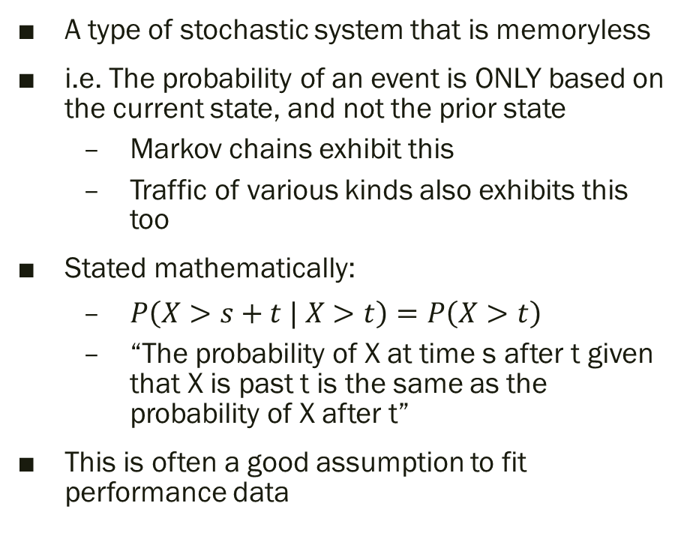
Markovian Property
A
A type of stochastic system that is memoryless
i.e. The probability of an event is ONLY based on the current state, and not the prior state
  Markov chains exhibit this
  Traffic of various kinds also exhibits this too
Stated mathematically:
  $P\left(X>s+t | X>t\right)=P\left(X>t\right)$
  “The probability of X at time s after t given that X is past t is the same as the probability of X after t”
This is often a good assumption to fit performance data
60%
40%
70%
C
20%
B
80%
30%
Markov chain

Slide 7
Exponential Distribution
A memoryless distribution, i.e. Markovian.
Continuous distribution → time is a continuous variable
Describes the time between events in a Poisson process, i.e. inter-arrival times
One parameter: λ or rate
  e.g. “we get a 2 customers per hour” is λ=2
Mean: 1/ λ
  e.g. “the average time between customers is ½ hr”

Slide 8
Coffee Shop Example
Suppose we have a coffee shop that, on average, takes 5 minutes to process a customer
Mean: 1/ λ = 5
  (minutes per customer)
Thus: λ = 1/5 customers per minute (c/m)
  This is the rate, because it’s a speed.
(keep this example in mind)

Slide 9
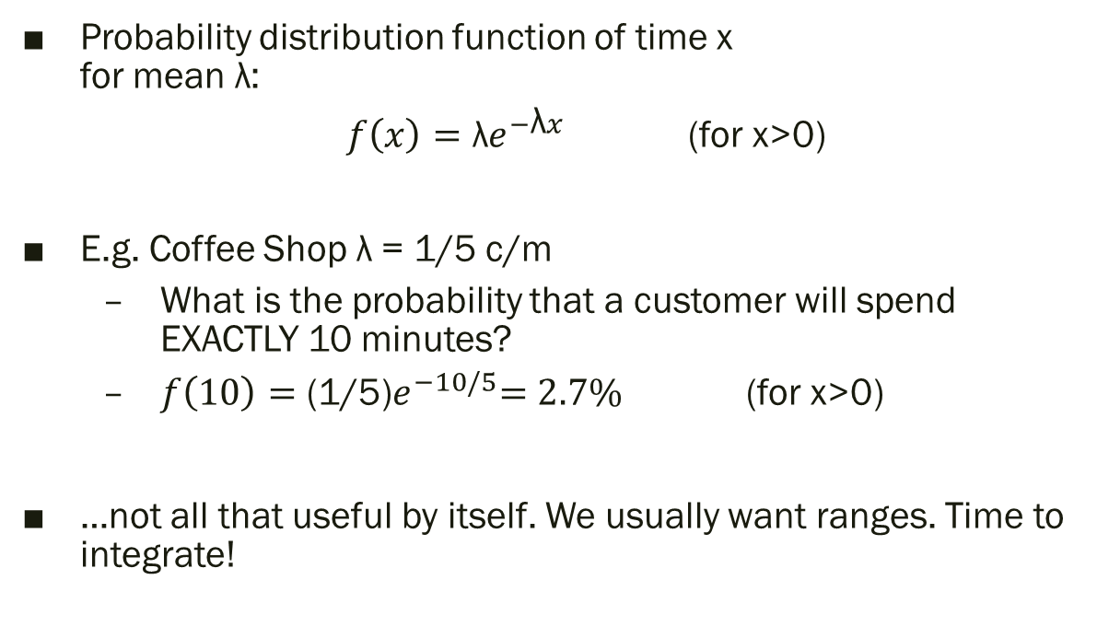
Exponential PDF
Probability distribution function of time x
for mean λ:
  $f\left(x\right)={\text{λ}e}^{−\text{λ}x}$ (for x>0)
E.g. Coffee Shop λ = 1/5 c/m
  What is the probability that a customer will spend EXACTLY 10 minutes?
  $f\left(10\right)={\text{(1/5)}e}^{−10/5}=2.7\%$ (for x>0)
…not all that useful by itself. We usually want ranges. Time to integrate!

Slide 10
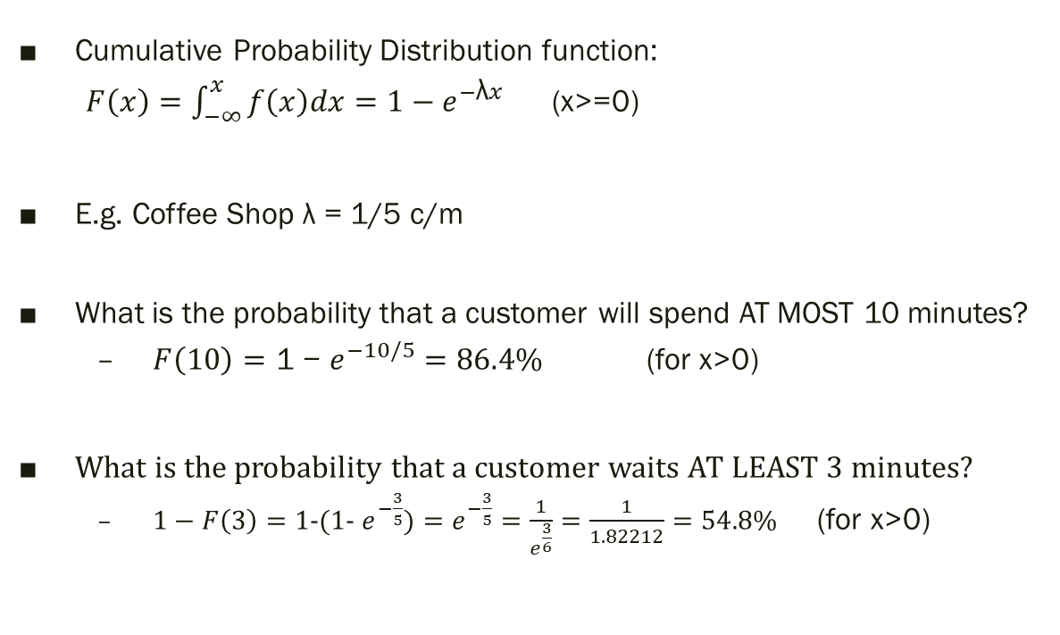
Exponential CDF
Cumulative Probability Distribution function:
  $F\left(x\right)=\int_{−∞}^{x}{f\left(x\right)dx}={\text{1 −} e}^{−\text{λ}x}$ (x>=0)
E.g. Coffee Shop λ = 1/5 c/m
What is the probability that a customer will spend AT MOST 10 minutes?
  $F\left(10\right)={\text{1 − }e}^{−10/5}=86.4\%$ (for x>0)
What is the probability that a customer waits AT LEAST 3 minutes?
  $1−F\left(3\right)={\text{1-(1-} e}^{−\frac{3}{5}})=e^{−\frac{3}{5}}=\frac{1}{e^{\frac{3}{6}}}=\frac{1}{1.82212}=54.8\%$ (for x>0)

Slide 11
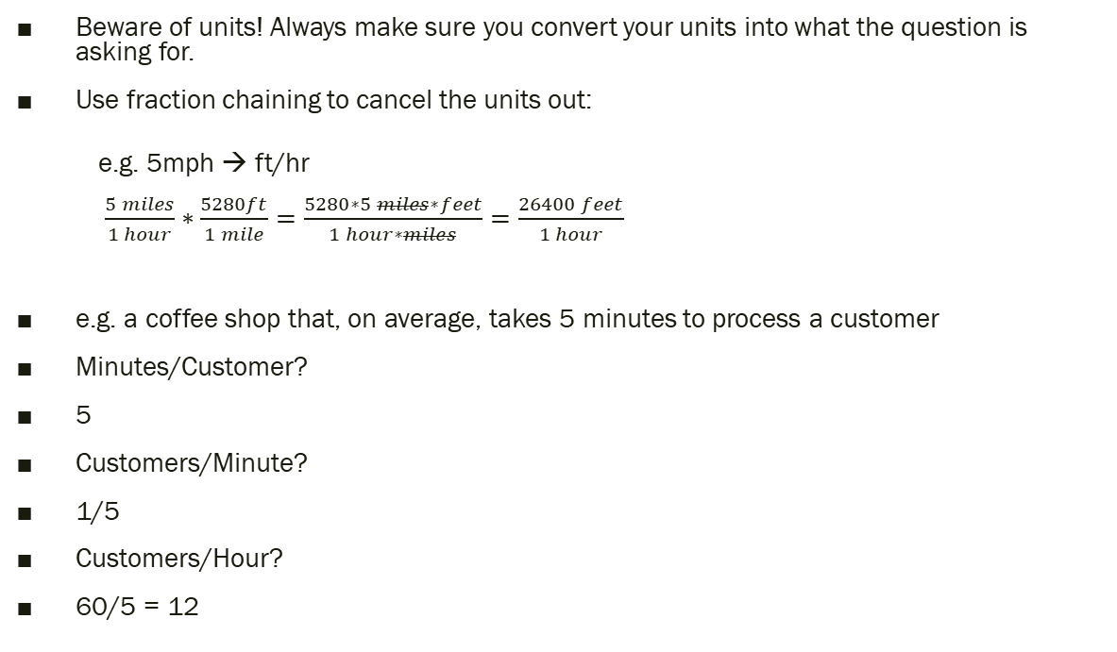
A Note About Units
Beware of units! Always make sure you convert your units into what the question is asking for.
Use fraction chaining to cancel the units out:
  e.g. 5mph → ft/hr
  $\frac{5 miles}{1 hour}∗\frac{5280ft}{1 mile}=\frac{5280∗5 miles∗feet}{1 hour∗miles}=\frac{26400 feet}{1 hour}$
e.g. a coffee shop that, on average, takes 5 minutes to process a customer
Minutes/Customer?
5
Customers/Minute?
1/5
Customers/Hour?
60/5 = 12

Slide 12
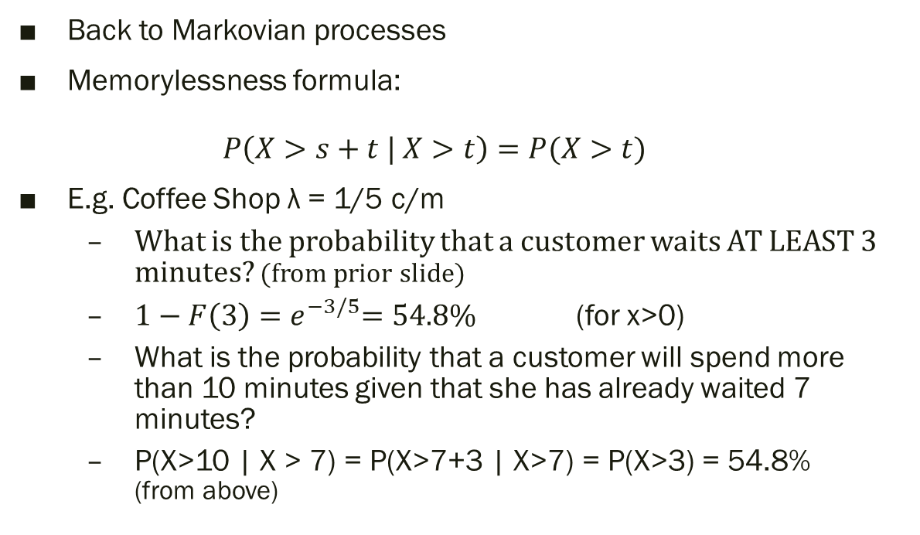
Memorylessness in Math
Back to Markovian processes
Memorylessness formula:
  $$P\left(X>s+t | X>t\right)=P(X>t)$$
E.g. Coffee Shop λ = 1/5 c/m
  What is the probability that a customer waits AT LEAST 3 minutes? (from prior slide)
  $1−F\left(3\right)={ e}^{−3/5}=54.8\%$ (for x>0)
  What is the probability that a customer will spend more than 10 minutes given that she has already waited 7 minutes?
  P(X>10 | X > 7) = P(X>7+3 | X>7) = P(X>3) = 54.8%
  (from above)

Slide 13
Let’s work on some problems
Go to myCourses and check out Queuing Theory Distributions
Feel free to work with your neighbors on this, but!
  Each “quiz” question will have different inputs, so…
  You will need to fill out your own answers.
These kinds of questions will be on the first exam.
You will get plenty of time to work on these questions in class as we go through Queuing Theory

