Slide 1







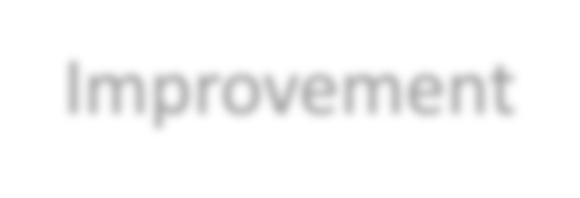

Software Measurement & Metrics
Software Metrics
Software Engineering Process
Understanding
Control
Improvement
SWEN-610
Foundations of Software Engineering
Department of Software Engineering Rochester Institute of Technology

Slide 2
What is Software Measurement?
Measurement is fundamental to any engineering discipline and software engineering is no exception
Why Measure Software?
  Establish the quality of the current product or process.
  To predict future qualities of the product or process.
  To improve the quality of a product or process.
  To determine the state of the project in relation to budget and schedule.
Software metrics offer an assessment of the impact of decisions made during software development projects.

Slide 3
A metric is not just a number.
A metric is a quantitative function that calculates some characteristic and produces a numeric measurement which will be used to make a decision.
For software product development, metrics fall into three broad categories:
  Process Metrics
    Activities related to production of software like effort required in the process, time to produce the product, number of defects found during testing, effectiveness of defect removal during development, maturity of the process
  Project Metrics
    Describe the project characteristics and execution like number of software developers, cost and schedule, productivity
Product Metrics
  Describe the characteristics of the product, such as size, complexity, design features, performance, efficiency, reliability, portability etc.

Slide 4
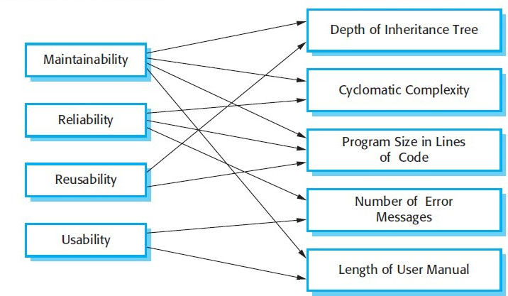
Several software quality attributes can be related to internal attributes through metrics
Software Quality Attributes (external) Internal Attributes

Slide 5
Dynamic and Static metrics
Dynamic Metrics are closely related to software quality attributes
  Collected by measurements made of a program in execution
  It is relatively easy to measure the response time of
  They help to assess the efficiency and reliability of a program
  Example: number of bug reports or the time taken to complete a computation
Static Metrics have an indirect relationship with quality attributes
  Collected by measurements made of representations of the system, such as the design, program, or documentation.
  Static metrics help assess the complexity, understandability, and maintainability of a software system
  Example: code size and the average length of identifiers used

Slide 6
Examples of Static Metrics
Software Metric | Description
Fan-in/Fan-out | Fan-in is a measure of the number of functions or methods that call some other function or method (say X). Fan-out is the number of functions that are called by function X.
Length of code | Measures the size of a program. Generally, the larger the size of the code of a component, the more complex and error-prone is it likely to be.
Cyclomatic complexity | Used to indicate the complexity of a program. It is a quantitative measure of the number of linearly independent paths through a program's source code.
Length of identifiers | The measure of the average length of identifiers (e.g. names for variables, classes, methods, etc.) in a program. The longer the identifiers, the more likely they are to be meaningful and hence more understandable the program.
Depth of conditional nesting | The measure of the depth of nesting of if-statements in a program. Deeply nested if-statements are hard to understand and potentially error prone.
Code Duplication | Indicates the amount of source code that occurs more than once in a program. Code Duplication is undesirable because it is associated with higher maintenance costs and can be indicative of bad design.
Fog index | Refers to a readability test that aims to determine the level of text difficulty, or how easy a text is to read. The higher the level, the more difficult the document is to understand

Slide 7
Even though you can count something, it does not necessarily count for anything.
A metric is only as good as the decisions that it will be used to make.
  Measuring something without it having a solid connection to possibly improving what you are doing is a waste of time and resources.
A measurement falling outside of a target range is not an absolute indictment.
Target values for measurements should be set based on a record of past measurements and resulting performance.
  Measurement not in some range ➔ some project quality was poorer
If measurements that do not fall in the target range indicate a place for additional scrutiny.
  For product metrics, they indicate possible "code smells".
  Places to consider for refactoring, redesign, or reimplementation

Slide 8
DORA
What it is: Four delivery metrics that correlate with software org performance.
Lead Time for Changes → commit → deploy (commit → green CI on main)
Deployment Frequency → how often we ship (merges to main per week)
Change Failure Rate → % deployments causing a failure (% merges that turn CI red or hotfix within 24h)
MTTR (Mean Time to Restore) → time from failure to recovery (class proxy: red CI → next green)
Forces small, safe, frequent changes.
Connects engineering habits to user impact and team reliability.
Encourages root-cause over vanity metrics.

Slide 9

SPACE
Why SPACE? Complements DORA by avoiding “activity myopia.” Looks at people, teams, and systems across five lenses.
S – Satisfaction & Well-being - How fulfilled do developers feel with their work, team, tools, or culture?
  Example: short weekly pulse (1–2 Qs) on workload clarity & stress.
P – Performance (outcomes, not lines of code) - Evaluate the outcome of a system or process. Performance is difficult to quantify because there are so many variables.
  Example: user-visible increments, test pass rate on main, defect escape rate across iterations.
A – Activity (what we do, not who we are) - Understand the number of actions or outputs completed in the course of performing work.
  Example: PR throughput, review latency, CI minutes. Use as context—not as grades.
C – Communication & Collaboration - Capture how people and teams communicate and work together.
  Example: PR review depth (comments/resolutions), ratio of solo vs. pair PRs, meeting notes artifacts.
E – Efficiency & Flow - Gauge how well developers and teams can make progress on their work or complete it without interruptions or delays.
  Example: PR cycle time, time-in-review vs. time-waiting, WIP limits adherence.

Slide 10
Coverage ≠ Confidence
What coverage tells you: how much code ran (lines, branches, conditions).
What it doesn’t: quality of assertions, oracles, or unseen behaviors.
Useful flavors (in order of bite):
  Line → Branch → Condition/Decision → Mutation score (killed ÷ total mutants).
  Mutation ≈ “tests notice small, realistic bugs.”
Confidence boosters (beyond %):
  Property-based tests & invariants (e.g., idempotence, order-insensitivity).
  Risk-based focus: higher targets on critical paths (auth, money, data loss).
  Golden/differential tests for integrations; perf/error percentiles (p95) in CI.
Anti-patterns:
  Chasing 90% line coverage with weak asserts/snapshots.
  Heavy mocking that hides real faults/IO paths.
  Covering trivial getters/setters while core logic stays unprobed.
  Flaky tests inflating “green” with retries.
Set targets as bundles, not a single number:
  Example: Tier-1 modules → Branch ≥ 70% and Mutation ≥ 60% and critical scenarios enumerated.
  Tier-2 → Branch ≥ 60% or Mutation ≥ 40% + smoke perf/error checks.

Slide 11
Architecture Signals
Coupling & Cohesion (module scale)
Afferent (Ca): # incoming deps; Efferent (Ce): # outgoing deps
Instability I = Ce / (Ca + Ce) (0 = stable, 1 = volatile)
Watch for high I at the core and low cohesion in “god” modules.
Change/Temporal Coupling (VCS-derived)
Files that co-change together across commits ⇒ hidden dependencies.
Flag triplets that frequently travel together (risky releases, coordination load).
Propagation Cost / Blast Radius
% of modules (transitively) reached by a change in module X.
High radius ⇒ fragile architecture; consider seams/anti-corruption layers.
Layering & Cycles
      Detect forbidden dependencies (UI → DB; domain → framework).
Tangles/cycles at package level are architectural “seams torn.”
Hotspots = Complexity × Churn
Prioritize modules with high cognitive complexity and frequent edits.
Great candidates for refactoring or strangler seams.
Abstractness vs. Instability (Martin)
Map packages on A–I chart; distance from “main sequence” indicates risk
Abstractness A = # abstract types / total types.
Interface & Boundary Health
Public API surface (count/volatility), fan-in/out at boundaries, duplicate adapters.
Versioned contracts, backward-compatible tests.

Slide 12
Runtime Metrics 101
Golden Signals (SRE)
  Latency (p50/p95/p99), Traffic (RPS/QPS), Errors (rate/ratio), Saturation (CPU/mem/DB pool).
  Prefer percentiles over averages; tails hurt users.
RED for Services
  Rate (requests/sec), Errors (5xx/timeouts), Duration (request time).
  Plot per endpoint; watch cardinality (label explosion).
SLIs → SLOs → Alerts – Service level indicator/Objective
  SLI (what we measure): “p95 /api/pay latency < 300ms.”
  SLO (target): “≥ 95% of requests meet SLI over 7 days.”
  Alert on error budget burn, not single spikes.
Minimal Instrumentation (student-scale)
  Log start/stop timestamps per request; compute p50/p95/p99.
  Count error outcomes (HTTP status classes).
  Track resource saturation (DB connections, worker queue length).
Test It, Don’t Guess It
  Synthetic checks for uptime/latency.
  Load tests: compare p95 and error rate before/after changes.
  Tracing: add a correlation ID; measure span times (DB, cache, external).
RPS – Requests per second, QPS – Queries per second, Saturation – CPU is full

Slide 13
Static Code Analysis Tools
Static code analysis tools scan all code in a project and seek out vulnerabilities, validates code against industry best practices, and some software tools validate against company-specific project specifications
They are used by software development and quality assurance teams to ensure the quality and security of code, and project requirements are met.
They can run within an IDE or integrate through a CI/CD Pipeline
Version Control
Unit Test
Static Code Analysis
Auto Test
Deploy to Production
Build
Deploy
Is the code coverage 90% or higher?
Any security vulnerabilities?
What is the Cognitive Complexity?
Any critical issues detected?

Slide 14
Static Code Analysis Tools
Advantages
  It can find weaknesses in the code at the exact location.
  It allows a quicker turn around for fixes.
  They can scan the entire code base.
  It permits weaknesses to be found earlier in the development life cycle, reducing the cost to fix.
Disadvantages
  They can produce false positives and false negatives.
  They can provide a false sense of security that everything is being addressed.
  They are only as good as the rules they are using to scan with.
Bottom-line
  These tools can be a cost-effective approach to measure and track software quality metrics but don’t replace other key processes like code reviews

Slide 15


Static Code Analysis Tools – SonarQube & SonarLint
SonarQube is an open-source platform for continuous inspection of code quality to perform automatic reviews with static analysis of code to detect bugs, code smells, and security vulnerabilities on 20+ programming languages including Java and TypeScript
  It offers reports on duplicated code, coding standards, unit tests, code coverage, code complexity, comments, bugs, and security vulnerabilities
SonarLint is an IDE extension that identifies and helps you fix quality and security issues as you code.
Both SonarLint and SonarQube rely on the same static source code analyzers using SonarSource technology

