Slide 1


Effective Team Communications
SWEN-610
Foundations of Software Engineering
Department of Software Engineering Rochester Institute of Technology

Slide 2
There are multiple stakeholders who have an interest in a software development project.
‘an individual, group, or organization, who may affect, be affected by, or perceive itself to be affected by a decision, activity, or outcome of a project’ (Project Management Institute, 2013)
Some of the project stakeholders include:
  Product owner (customer/sponsor)
  Product users
  Project team members
  Manager
Each stakeholder has a different set of interests and communication needs.

Slide 3
The Product Owner is mainly concerned that the project satisfies their needs.
Is the team building the right project?
  Vision statement for features
  Enumeration of epics and user stories
  Priority of user stories
Is the team building the project right?
  Acceptance tests for each story
Term project
  Instructor is the Product Owner
  Trello board for detailing epics and user stories with priority and acceptance criteria
  If it is not in the Trello board, it is not in the project

Slide 4
The Product Users are concerned with the overall user experience.
What is the user experience?
  User interface design
  Workflow for using the product
  Interface with other elements of the business processes
Project teams, unfortunately, often do not directly deal with the user or only do so through a proxy.
Term project
  Instructor and course assistants as users
  Other teams during cross-team testing

Slide 5

Project team members must communicate about the technical aspects of the project.
Requirements
  User story creation with Product Owner (Trello board)
Design
  Architectural design (UI – Application – Model)
  Structural design (UML class structure diagrams)
  Behavioral design (UML sequence and statechart diagrams, web application interface)
  Design narratives (Design discussion)
  Whiteboard designs
Code
  Coding style guidelines (Google Java style)
  Code reviews (GitHub pull requests)
  Version control support (GitHub)
Elements in ()s are related to term project

Slide 6
Project team members must communicate about the process of doing the project.
Planning
  Sprint planning and backlog refinement (Trello board)
Operational information
  Stand-up meetings (in-person, Skype/Hangout, Slack)
  Information exchange (Slack)
  Information archive (Trello card)
Team coordination
  Meeting scheduling (Doodle, When2Meet)
  Information exchange (Slack)
Telling others about the project
  (Demos and presentations)
Elements in ()s are related to term project

Slide 7
Your team must determine what communication can be virtual and what is better face-to-face.
Improved communication is the #1 item that teams say would help them be more effective
Most would agree that a face-to-face meeting is the best for communication.
The nature of modern software development often does not permit this.
An effective software development team balances
  Virtual vs face-to-face meeting
  Asynchronous vs synchronous communication
BUT…most work will be done asynchronously including coding

Slide 8
A Standup Meeting is a nearly daily form of team communication. Here's how it works…
A standup is a time-boxed meeting that relates progress and commitments across the team.
  This is the Development Team's meeting to run
  The Product Owner may be present
Each team member answers three questions:
  What did I do yesterday?
  What will I do today?
  Are there any impediments to achieve my task?

Slide 9
What are some common gotchas running a Standup Meeting?
Examples:
  A non-team-member is directing the meeting
  Team lets the meeting run too long
  People sit and get too comfortable
  People digress on technical issues
  People try to solve the impediment
  People try to debate the merits of alternate solutions
Solutions?
  Team must have discipline to cut-off rambling
  And to take debates and solutions out of the meeting
    Identify someone to help the person
    And move on

Slide 10
The Manager is interested in progress and individual accountability.
Project progress and projections
  Card flow through lists (Trello board)
  Product backlog (Trello board)
Individual accountability
  The Manager (your Instructor) needs to know who has done what work on the project.
  Team members need visibility in artifacts
    Trello card log
    Slack channel presence with meaningful contributions
    Code level contributions
      Commits performed
      Issues opened/closed
      Pull requests issued/reviewed
    Peer evaluations
Elements in ()s are related to term project

Slide 11
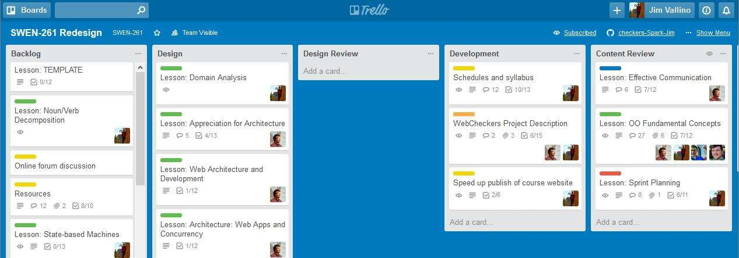
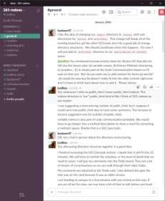
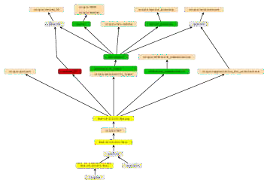
These same tools were used while developing the course and every term while it is taught.
Planning with Trello board
Communication and coordination
using Slack channels
Content development using Git with a feature branch for each topic

