Slide 1
Full Stack Development and
Model View Controller
SWEN-610 Foundations of Software Engineering

Slide 2
Full Stack Development
Full stack is a catchy term for the way different technologies send, and receive, data from one another in order to implement a cohesive application. Typically a web application.
  You can visualize them as a stack (i.e., the data structure) of technologies that are connected via the inputs they receive and the outputs they produce
For Web Applications this typically means you have (roughly*):
  One or more front-end technologies (e.g., HTML, CSS, React)
  Some kind of server technology (e.g., nodejs, express, asp)
  Some kind of database technology (mongodb, mysql, postgresql)
There can be things between those depending on how specific we want to be. Could consider react/angular/vue to be front end frameworks (i.e., they generate html/css) while html/css are front-end languages*. But the list above is more or less a generic full stack.

Slide 3
Stack Examples
You will likely run into several stack abbreviations. Here are a few examples:
  MEAN Stack: MongoDB, Express, AngularJS and Node.js.
  MERN Stack: MongoDB, Express, ReactJS and Node.js
  LAMP Stack: Linux, Apache, MySQL and PHP.

Slide 4
So what does stack mean?
1. Backend Layer (Data + Domain Rules)
  Database engine (e.g., PostgreSQL, MongoDB)
  Data storage, queries, constraints, transactions
  Sometimes wrapped by ORMs or service logic
  Represents the Model in MVC/MVVM thinking
  This is the “source of truth” for the application.
2. Middleware / Server Layer (Application Logic + APIs)
This layer is the runtime environment + framework that exposes application behavior.
What it typically includes:
  A runtime (Node.js, Python, PHP, Java, .NET CLR)
  A web server framework (Express, FastAPI, Django)
  Routing, controllers, auth, caching, serialization (JSON)
Sometimes even:
  An entire operating system layer (Linux in LAMP)
  A process manager (PM2, Gunicorn, systemd)
  Package/dependency systems
  Node = npm/yarn
  Linux = apt/yum/pacman
3. Front-End Layer (UI + User Interaction)
  Everything responsible for rendering the application in the browser:
  HTML, CSS, JS
  Frameworks like React, Angular, Vue
  The user-visible View, plus local logic and state
  This layer communicates with the middleware over HTTP/JSON.

Slide 5
Let’s go through a couple
MERN Stack: MongoDB, Express, ReactJS and Node.js
  MongoDB is the database. Uses JSON-like documents for interacting with data; it integrates well with the “javascript everywhere” philosophy of this stack
  Express is your web server. It allows you to define your routes and endpoints amongst other server concerns
  ReactJS is a front-end UI development tool that you use to define your application view
  Node.js is the application runtime for MEAN stack. It is a javascript runtime environment for executing javascript outside of the web browser. It is the technology that ExpressJS and ReactJS are built on.
LAMP Stack: Linux, Apache, MySQL and PHP.
  Linux is the base of this stack. Provides package management and stability
  Apache is the webserver. This is where you’ll define your routes and endpoints amongst other concerns
  MySQL is the database. For this stack, we are using a relational database.
  PHP is the front-end UI development language for this stack. It is how we will generate the webpage to be rendered in the browser

Slide 6
Software Architecture
Architecture = How a System Is Organized
It describes the high-level structure of a software system:
  How responsibilities are divided
  How components communicate
  How data flows through the system
  How the system is deployed and executed
Architecture is about:
  Boundaries
  Responsibilities
  Constraints
  Interaction patterns

Slide 7
Architecture vs. Programming Patterns
Architecture Patterns
  High-level system organization
  Define how responsibilities are split
  Describe data flow and component interaction
  Examples: MVC, MVVM, Layered Architecture, Client–Server
  Concerned with: Where does this logic belong? How do parts talk?
Programming Patterns (Design Patterns)
Local code-level solutions
  Solve recurring micro-problems inside components
  Provide reusable structures for small-scale logic
  Examples: Strategy, Observer, Factory, Adapter
  Concerned with: How do I structure this piece of code?
  These act like idioms within the architecture.

Slide 8
Model View Controller Definition
Model
The application’s data and rules.
Represents the state of the system (objects, records, domain constraints).
Independent of UI: the Model should be usable without any knowledge of how it’s displayed.
View
Everything the user sees and interacts with.
Renders Model data into a UI (HTML, JSON, templates, components).
Should not contain business logic, only presentation logic.
Controller
The glue between user actions and application behavior.
Receives input (clicks, HTTP requests, forms), updates the Model, and selects a View.
Defines what should happen when the user tries to do something.

Slide 9
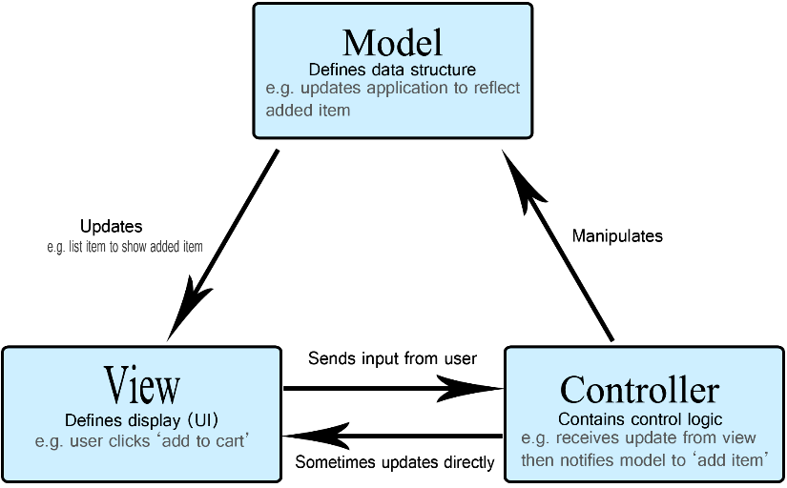
Diagram

Slide 10
Advantages to MVC
Separation of concerns + Loose coupling
  Dividing the logic between the model, view, and controller groups all of the code that deals with any individual concern. Changes to components tend to not effect others.
  We can freely change the internals of any individual piece without worrying whether the controller or the view will be able to interact with it
    The view can change to support multiple, drastically different views
    The model can support more data or change the types of data it supports
    The controller is free to modify how it handles requests internally
  As long as their input and output formats remain the same, the other two components will likely not need to be modified. Changing input/output formats tend to be easy changes to make when it does need to happen.

Slide 11
Disadvantages to MVC
Can Be Too Abstract for Real Web Stacks
  MVC was born for single-process GUIs
  Modern apps span multiple runtimes, networks, and languages
  Students often struggle because MVC alone doesn’t map perfectly to React + APIs
  Debugging requires hopping mental contexts (DB → API → client logic → UI rendering)
Coordination Overhead
  Backend changes require frontend changes and vice-versa
  API contract drift causes subtle bugs
  Versioning APIs becomes a real headache
Sometimes the frontend can get overly complicated with business logic while the controller becomes too thin

Slide 12
Model View View-Model (MVVM)
Model
Domain data + business rules (same as MVC).
View - What the user sees
HTML, rendered components, DOM.
ViewModel - The UI’s brain.
Holds UI state, transforms Model data for the View, handles user actions, and talks to the backend. Not responsible for rendering, just logic and state.

Slide 13
Something to think about
But What Architecture Did We Actually Build?
  Based on what you now know about MVC and MVVM:
  Which parts of our stack behave like Models?
  Which parts behave like Views?
  Which parts behave like Controllers?
  Does React feel more like MVC… or something else?
  Where does “UI logic” really live in our app?
  Where does the “View” come from if FastAPI never returns HTML?
You worked with:
  PostgreSQL (persistent data)
  FastAPI (HTTP routes + JSON APIs)
  React (components, hooks, rendering)

Slide 14
So what are we using?
Backend (PostgreSQL + FastAPI)
Model (Domain + Persistence)
  PostgreSQL tables
  Data constraints, relationships
  ORM or query layer (if used)
Controller / API Layer
  FastAPI path operations
  Request → validate → run logic → return JSON
  This is “Controller-ish,” producing data for the front end but not a traditional View
Frontend (React)
Model (Client-Side Data)
  JSON responses stored in component state
  Derived/calculated data based on API results
ViewModel (React component logic)
  Component functions and hooks (useState, etc)
  Event handlers (onClick, onSubmit)
View (Rendered UI)
  JSX returned from components
  The DOM presented to the user
  Automatically re-renders when ViewModel state changes

Slide 15
Conclusion
Full stack web development refers to a set of technologies that are used to implement a fully-functional application. In our case, a web site/web application
Full stack acronyms describe the technologies that are part of a defined stack. These technologies are what you need to implement the application using that stack.
For our applications
The backend behaves like Model + Controller
The frontend behaves like ViewModel + View
JSON forms the seam between the two
Together, they create a distributed version of MVC/MVVM

