Slide 1
Seven Basic Quality Tools

Slide 2
Objectives
Introduce some basic quality analysis and control tools for gaining insight from metrics
Seven “Basic” Quality Tools
Plus a few “additional” tools
These are tools to ...
Analyze quality metrics data to gain insight on attainment of quality goals and opportunities for quality improvement
Focus quality assessment and improvement activities on high-value results

Slide 3
The Seven Basic Tools
Checklists (Checksheets)
Pareto Diagrams
Histograms
Run Charts
Scatter Diagrams (Scatter Plots)
Control Charts
Cause-and-Effect (Fishbone) Diagrams

Slide 4
What Are These Tools?
Simple techniques to:
Track quality performance and trends
Identify the existence of quality problems
Analyze and gain insights into the causes and sources of quality problems
Figure out which problems to address
Help eliminate quality problems
Defect prevention, not just detection and correction
Basic knowledge for anyone interested in quality, engineering problem solving, and systems design
Probably already familiar with most of these

Slide 5
Why Exactly Seven Tools?
Kaoru Ishikawa promoted the notion of seven basic tools that could be used to address quality
Designed for manufacturing environments, but applicable to engineering & management, too
There are other very useful tools:
Templates, workflow automation
Pie charts and other graphical representations
Relationship diagrams, tree diagrams, etc. (“Seven new quality tools”)
System dynamics diagrams and influence diagrams
We learn a basic subset here, others left to “lifelong learning”
Corporate training often introduces/uses quality tools & techniques
See the American Society for Quality (http://www.asq.org/)

Slide 6
What to Learn About Each Tool
What is the tool?
How is it used?
For what purposes is it useful?
What value does it add?
What are its limitations?
How can it be used effectively?

Slide 7
Histogram
A bar graph showing frequency counts
X axis often a nominal or ordinal scale; Y axis is how often that X value occurred in measurements or observations
Use/value: Easy to see relative magnitudes / frequencies
Sometimes low frequency items are of interest
For example, dissatisfied customers: histogram may “minimize” these high-impact but infrequent occurrences
Can use different color or other ways to highlight importance
Sometimes multiple bars for each item (e.g. last year / this year), to show trends and changes
Pie chart representation useful if these are parts of a whole
Not very good if there are several low-frequency items of interest
Sometimes cumulative frequency line added to show “total at or below this level” – useful if X axis is ordinal scale

Slide 8
Histogram Example: A Pizza Shop
# times ordered
Slices of Pizza
From http://www.freequality.org
Notes:
Helpful in showing orders frequencies and variation.

Slide 9
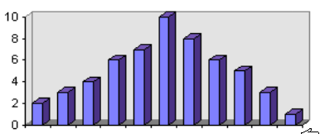
Example: Distribution of Component Size
Frequency
< 1
1-2
2-3
3-4
4-5
5-6
6-7
7-8
8-9
9-10
> 10
Component Size (KLOC)

Slide 10
Run Charts
Plot of some measurement/metric vs. (usually) time
Use this when X axis is interval or ratio scale, such as project time, component size, team size, etc.
Often used to show trends over time
Easier to spot overall upward or downward trend, or cyclical variations and other patterns
Visually separate random from significant variation
Major spikes or valleys are triggers for explanation, investigation, or action
Value: Identification of problems, trends, unexpected good results (may learn a lot from these)

Slide 11
Run Chart Example for Pizza Shop
Slices/hour
A rainy day
5 10 15 20 25 30 35 40 45 50 55 60 65 70 75 80 85 90 95 100
Getting Warmer
8 9 10 11 12 1 2 3 4
8 9 10 11 12 1 2 3 4
8 9 10 11 12 1 2 3 4
Time
PM- AM
PM- AM
PM- AM
Thursday
Week 1
Thursday
Week 2
Thursday
Week 3
From http://www.freequality.org
Notes:
Ask the class what trends they can identify. Week 2’s Thursday was a rainy day. Business Peaks between 1 and 3 each night so this is very valuable information to the management. Also with the exception of the rainy day, business seems to increase with warmer weather. Have the class come up with any other trends they can see or ideas to help improve quality based on this information. Such as higher staffing between 1 and 3 or higher inventory levels/preparation etc.

Slide 12
Cause-And-Effect (Fishbone) Diagram
Diagram showing hierarchical structure of causes that contribute to a problem or outcome:
Problem of interest forms the backbone
Spines are causes that contribute to the problem
Spines may have bones that represent its contributory factors and so on
Used in brainstorming to diagram and identify various possible factors contributing to a problem, and to identify causal sequences (A causes B causes C) and root causes
Very simple but extraordinarily useful tool
Initially both minor factors (that occur rarely or contribute very little) and major causes may all get listed

Slide 13
Example Fishbone Diagram
Example: High Inventory Shrinkage at local Drug Store
employees
attitude
training
new trainee
benefits
practices
Shrinkage
Anti-theft tags poorly designed
Expensive merchandise out in the open
No security/ surveillance
shoplifters
From http://www.freequality.org
Notes:
With the completion of the diagram, several points have been made about inventory shrinkage’s possible sources. These may or may not have been obvious to management before this brainstorming process occurred.

Slide 14
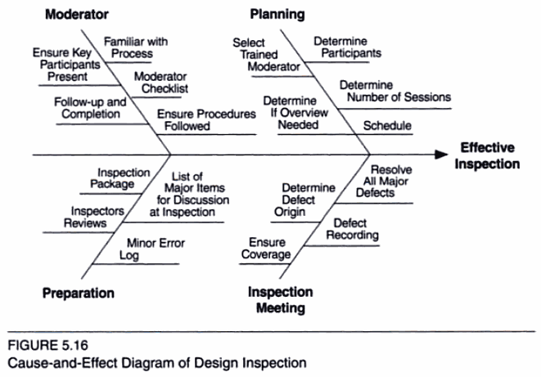
Design Inspection Example from Tian Textbook

Slide 15
Pareto Diagram
Histogram arranged by decreasing frequency
Used to identify causes that contribute most to the problem
After fishbone analysis, may do data gathering to figure out the frequency with which each cause contributes to the problem
In software, review reports are good data sources
Plot histogram, identify the major causes
Based on Juran’s Pareto Principle – the 80/20 rule
“80% of the effects come from 20% of the causes”
Indicates general principle that some causes likely to be a lot more significant than others
Highest cost-benefit from addressing the most significant problems
Less significant problems may barely be worth addressing

Slide 16
Pizza Shop Example
# times ordered
2
1
4
3
7
5
6
Slices of Pizza
From http://www.freequality.org
Notes:
This sheds light on the most frequently ordered quantities. It is also common to plot percentages on the same graph.

Slide 17
Four Basic Defect Prevention Tools
Checklists
Templates
Processes
Workflow automation

Slide 18
Checklists
Once we identify the causes of problems, how do we eliminate them?
Checklists are simple and incredibly effective at preventing & eliminating defects on repetitive tasks
To Do lists, “did you ...” on bill payment envelopes, etc.
Capture knowledge about common problems and how to avoid them
Can be used in review processes to identify problems
Lightweight: low additional effort to use (not zero!)
Checklists that become too long lose value (use Pareto analysis!)

Slide 19
Flowcharts (Process Diagrams)
Flowcharts show sequencing of activities and decisions
Depiction of processes for doing things
Streamline the flow of activities
Capture knowledge about how to perform activities effectively
Eliminate problems due to missed activities and badly sequenced activities
Can be used to analyze and implement improvement ideas:
Good processes can save work and avoid problems
Less than zero cost for improving quality
Should always be the goal of process design

Slide 20
Flowchart Example for Pizza Shop
From http://www.freequality.org
Window
(start)
Take Customer Order
Money?
yes
no
Get Pizza
Lock Up
Put More in Oven
no
2 Pies
Available?
yes
no
Time to Close?
yes
Take to Customer
Notes:
Answer: Since we know that 2 slices is the most common order we could possibly add a step between Time to close and take customer order. If we brought two slices up to the window during peak hours this would quicken service. There are multiple improvements that can be made on the process. The class can brainstorm on ways of improving this flowchart.
Note that a decision must be made at each triangle before the next step can begin.

Slide 21
Templates (A Type of “Checklist”)
Templates are another near zero-cost defect elimination mechanism
Pre-created document structure
Often pre-populated with “boilerplate” stuff: standard explanations, disclaimers etc.
Avoids problems due to missing information, incompleteness
Avoids problems in activity for which the document is the output
Need to fill in form, so get the data/do the activity!
Problems with templates:
Not all sections are always applicable; may sometimes want different structure
Can constrain people from doing what they need to
Can lead to “automaton” mode where people just fill in form without thinking if that’s the most appropriate thing to do
Make templates as guidelines, not “set in stone” forms

Slide 22
Are you using the document outline of your project as a checklist?

Slide 23
Workflow Automation
Creation of computerized tools that streamline activities, such as automated check-in and build, automated testing
Implements process, templates
Eliminates many kinds of defects
Saves effort
Flexibility is often a major problem
If the needs are different from what the tool supports, can’t do it at all (or significant work-arounds)
Designing flexible tools which automate workflow is a major technical challenge

Slide 24
Scatter Diagram
Used to determine whether there is really a relationship between two variables
Fishbone cause-effect diagramming identifies possible causes
Doing a scatter plot can show whether the proposed cause and its effect are correlated
Visual plot can show degree of correlation, non-linear correlations
Often annotate fishbone diagram to show whether a possible cause-effect has been shown to be statistically correlated
Linear correlations if most points are along a straight line
Poor (linear) correlation if points scattered all over
Remember: correlation does not imply a causal relationship!

Slide 25
Scatter Diagrams Measuring Relationships Between Variables
Copyright 2002 The Agility Group and University of Durham
Positive Correlation
Negative Correlation
No Correlation
An increase in y may depend
upon an increase in x.
An decrease in y may depend
upon an increase in x.
Positive Correlation?
Negative Correlation?
There is no demonstrated
connection between x and y.
Non-Linear
Correlations?
If X is increased, y may also
increase.
If X is increased, y may
decrease.

Slide 26
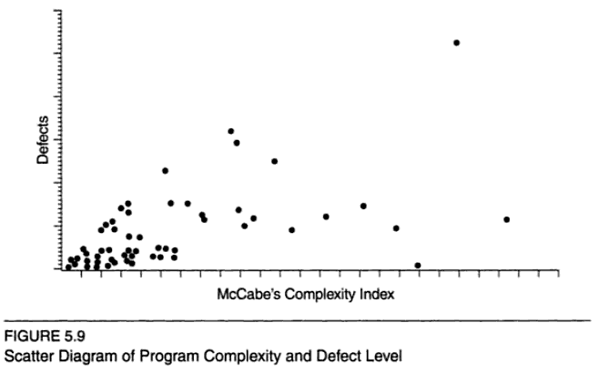
Example Scatter Plot from Tian Text

Slide 27
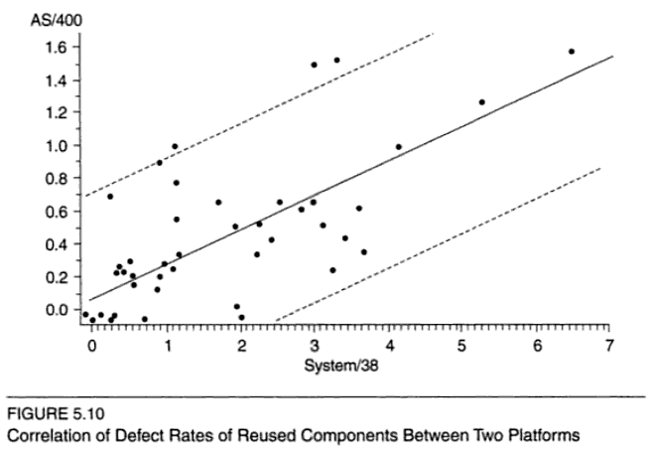
Example Scatter Plot from Tian Text
0.69 Correlation Coefficient
95% Confidence Interval
Linear Regression Line

Slide 28
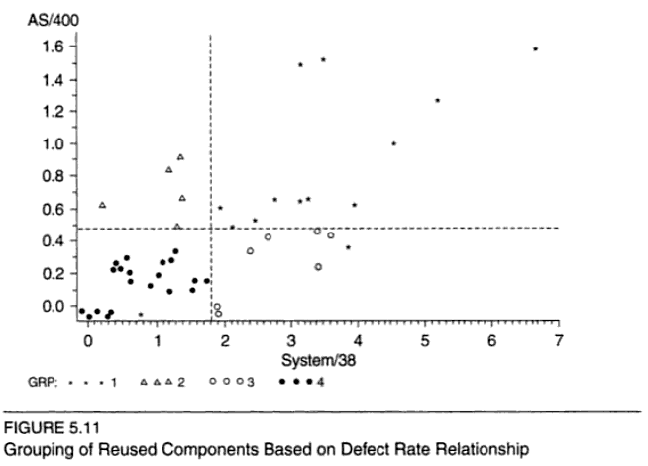
Example Scatter Plot from Tian Text
Classify the scatter plot according to medians of component defect rate
Apply different analysis and improvement strategies to different quadrants
Components with high defects in both systems
AS/400

Slide 29
Control Charts
Plot of a metric with control limits defined
Upper control limit: If value of metric exceeds this, take action
Lower control limit: If value goes below this, take action
Warning levels: If value outside this, check if all is well
Control limits may be derived statistically or less formally (based on “reasonable” values or other impacts)
Formal statistical process control has formulas for deriving limits: often 3 sigma deviation from desired outcome
Useful to flag “outlier” values, such as components with very high defect rates, projects that have parameters outside “normal levels” etc.
Formal statistical process control not used much in software

Slide 30
Control Charts -- Pizza Example
Upper Limit
17 inches
Lower Limit
15 Inches
16 inches=
X
From http://www.freequality.org
Small Pie
Notes:
Monitoring the pizza process, this example shows how almost every pie is within specifications. The process should be analyzed to discover why the one small pie was produced and corrected to improve quality.

Slide 31
Conclusion
The quality tools provide a suite of methods for quality analysis and control:
Histograms, run charts, control charts can identify problems
Fishbone is used to brainstorm possible causes
Scatter plots can be used to analyze whether relationships exist
Pareto analysis identifies which causes are most worth addressing
Checklists, templates, process definition and workflow automation can prevent problems

