Slide 1
Software Reliability Engineering

Slide 2
Objectives
Look at some details on Software Reliability Engineering (SRE)
Steps in the SRE process
Setting reliability objectives
Using operational profiles to guide effort
Interpreting reliability trend graphs

Slide 3
Reliability Focus
“Testing can only prove the presence of errors, not their absence.”
Dijkstra
So, focus on reliability, not defects
Correctness

Slide 4
Software Reliability Engineering
Software Reliability Engineering (SRE) addresses the measurement, modeling, and improvement of software reliability
Use quantitative information to choose the most cost-effective software reliability strategies for your situation

Slide 5
Reliability Engineering Practices
Define reliability objectives
Use operational profiles to guide test execution
Track failures during system tests
Use reliability growth curves to track quality of product
Release when quality of product meets reliability objectives

Slide 6
SRE Waterfall
Establish
Reliability
Objectives
Engineer “Just
Right” Reliability
Develop
Operational
Profiles (OPs)
Plan Tests
Matched to OPs
Predict software reliability growth
Trade-offs between time, reliability, cost, performance, etc.
When to stop testing – release decision
How much post-release support to plan for
Use Test
Results to
Drive Decisions
(Fielded System)
Determine Achieved
Reliability and OPs

Slide 7
Reliability and Failure Intensity
Failure intensity: Number of failures per hour of operation
Reliability is the inverse of failure intensity (FI)
Reliability
FI
R
Failure
Intensity
TIME

Slide 8
Defining Reliability Objectives
Set quantitative targets for level of reliability that make business sense
Impact of a failure FI Objective MTBF 100’s deaths, >$10⁹ cost 10⁻⁹ 114,000yrs 1-2 deaths, around $10⁶ cost 10⁻⁶ 114 yrs $1,000 cost 10⁻³ 6 weeks $100 cost 10⁻² 100 h $10 cost 10⁻¹ 10 h $1 cost 1 1 h
From John D. Musa

Slide 9
Operational Profiles Guide Effort
Guide software development priorities and quality effort by what the user will use the most often
Pareto principle: 20% of the software’s functionality or “size” may satisfy 80% of the user’s needs
Operational profiles expose most frequently used product features

Slide 10
http://agile.csc.ncsu.edu/testing/SREChapter2.pdf

Slide 11
Testing Based on Operational Profiles
Done during black-box system testing
Mix of test cases that match operational profile
If possible, create automated test harness to execute test cases
Need to run large numbers of test cases with randomized parameters for statistical validity
Execute test cases in randomized order, with selection patterns matching frequencies in operational profile
Simulating actual pattern of usage

Slide 12
Studying Patterns in the Trends of Reliability Growth

Slide 13
Reliability Metric
Estimated failure intensity
(Reliability = 1 / failure intensity)
Use reliability tracking and analysis tools to show actual (to date) and predicted (future) estimates of how failure intensity varies over time
The curve is referred to as the “reliability growth curve”
Note that the product being tested varies over time, with fixes and new code
In-process feedback on how quality is changing over time

Slide 14
Code Integration/Build Patterns
Most large projects have periodic builds
Development team integrates a new chunk of code into the product and delivers to test team
Test team does black box system testing
Identifies defects (failures) and reports them to development team
Track pattern of defects found during system testing to see how reliability varies as development progresses
Defects found should decrease over time as defects are removed, but each new chunk of code adds more defects
Pattern of reliability growth curve tells us about the code being added, and whether the product code is becoming more stable
Pattern can also be used to statistically predict how much more testing will be needed before desired reliability target reached
Useful predictions only after most of the code is integrated and failure rates trend downward

Slide 15
Tracking Failures During Testing
Enter data about when failures occurred during system testing into reliability tool such as CASRE (Computer-Aided Software Reliability Engineering tool) or Statistical Modeling and Estimation of Reliability Functions for Software (SMERFS)
Plots graph of failure intensity vs. development/test time
Reliability
In concept, a nice smooth curve of reliability growth
FI
R
Failure
Intensity
TIME
From netserver.cerc.wvu.edu/numsse/Fall2003/691D/lec3.ppt

Slide 16
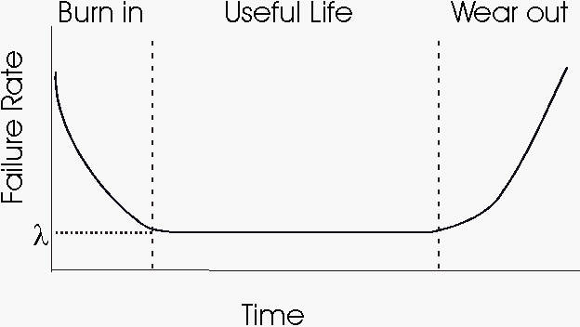
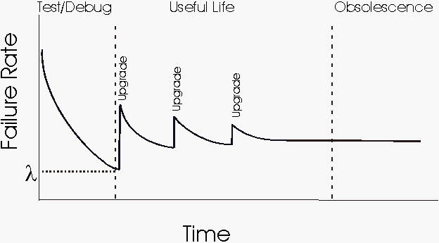
Reliability Over Time
Hardware “Bathtub” Model
Software Model
[DACS Software Reliability Source Book]

Slide 17
Predicting with a Software Reliability Growth Model
[Rakitin]

Slide 18
A More Realistic Curve During Development
From http://www.stsc.hill.af.mil/crosstalk/1996/06/Reliabil.asp

Slide 19
Many Statistical Models of Reliability Growth
The Statistical Modeling and Estimation of Reliability Functions for Software (SMERFS) contains a collection of several reliability models, including:
Get SMERFS at http://www.slingcode.com/smerfs/
The Littlewood-Veral Bayesian model
The Musa execution time model
The geometric model
The nonhomogeneous Poisson model for execution time data
The Musa logarithmic Poisson execution time model
The generalized Poisson model for interval data
The nonhomogeneous Poisson model for interval data
The Brooks-Motley discrete software reliability model
The Schneidewind maximum likelihood model
The Yamada S-shaped reliability growth model

Slide 20
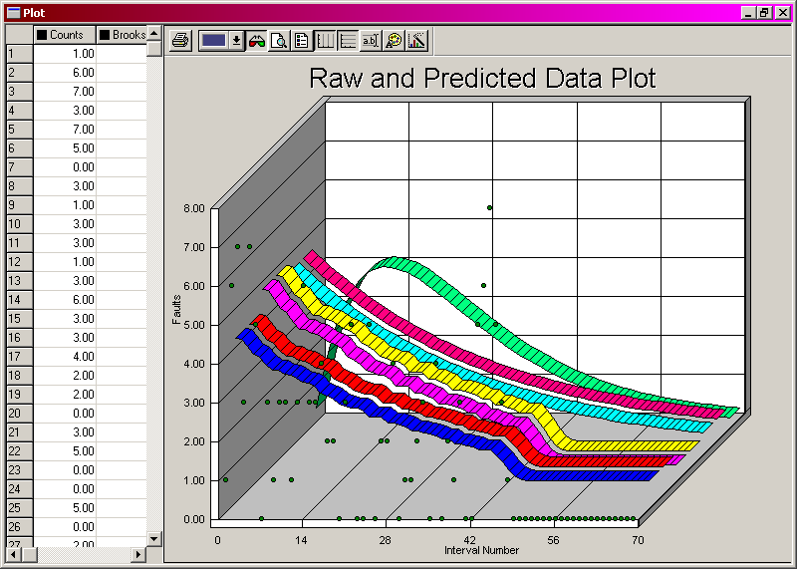
Model Comparison Using SMERFS^3
[Dolores R. Wallace Practical Software Reliability Modeling]

Slide 21
Interpreting Reliability Growth Curves
Spikes are normally associated with new code being added
Larger volumes of code or more unreliable code causes bigger spikes
The curve itself tells us about the stability of the code base over time
If small code changes/additions cause a big spike, the code is really poor quality or impacts many other modules heavily
The code base is stabilizing when curve trends significantly downward
Release (ideally) only when curve drops below target failure intensity objective … indicates right time to stop testing
Can statistically predict how much more test effort needed before target failure intensity objective needed

Slide 22
Limitations of Reliability Curves
Operational profiles are often “best guesses,” especially for new software products
The reliability models are empirical and only approximations
Failure intensity objectives should really be different for different criticality levels of different kinds of failures
Results in loss of statistical validity!
Automating test execution is challenging (particularly building verifiers) and costly
But it does save a lot over the long run
More worthwhile when reliability needs are high
Hard to read much from the growth curves till later stages of system testing … very late in the development cycle

Slide 23
Reliability Certification
Another use for reliability engineering is to determine the reliability of a received or acquired software product: Certification of Acceptability
For example, you are evaluating web servers for your company website – reliability is a major criterion
Build a test suite representative of your likely usage
Put up some pages, maybe including forms
Create test suite that generates traffic
Log failures such as not loading, wrong data received, server time out
Track failure patterns over time
Evaluate multiple products or new releases using test suite, to determine reliability
Avoids major problems and delays with poor vendor software
Note that this applies the analysis to a fixed code base
Fewer problems with statistical validity

Slide 24
Example Certification Curve
Run the product and track the time of occurrence of each failure
Failure #1 Decision: Don’t know enough yet, so continue running
Failure #2 Decision: Don’t know enough yet, so continue running
Failure #3 Decision: Came far enough later (in MTBF sense) that the product is certified acceptable
Had failures #3-7 happened as shown by the x’s, then the failures are occurring too frequently -- Reject
x
x
x
x
Based on http://www.stsc.hill.af.mil/crosstalk/1996/06/Reliabil.asp

Slide 25
Summary
Software Reliability Engineering is a scientific (statistical) approach to reliability
Vast improvement over common current practice
“Keep testing until all our test cases run and we feel reasonably confident”
Avoids under-engineering as well as over-engineering (“zero defects”)
When done well, Software Reliability Engineering adds ~1% to project cost
Musa’s numbers: ~10% for medium-sized projects if you include cost of automated testing
Note that as the number of builds and releases increases, automated testing more than pays for itself

